Slide 1

EOSC-hub Data Platforms for data processing and solutions for publishing and archiving scientific data
Presented by: Lukasz Dutka, Bartosz Kryza

Slide 2
ONEDATA

Slide 3










WHO WE ARE?
6+ years devoted development
Main goal is:
  to deliver data management platform for large scale and distributed problems
  to make the solution decentralized and eventually consistent in order build a mesh of data sources
  to deliver virtual file system for hybrid cloud
The work is supported by:

Slide 4


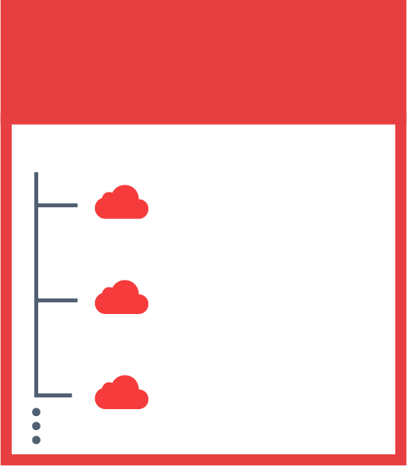

ONEDATA – FOR FAIR
JOHN’S SPACES
SENTINEL 2
DEEP LEARNING
SARA’S SPACES
PUBLICATIONS
SENTINEL 2
SKY MAPS
MY DATA

Slide 5
PROBLEMS ADDRESED BY ONEDATA PLATFORM
Multi-protocol transparent access to data “[…] but we want POSIX”
Heterogeneity of storage technologies
Replica Management
Easy Data Sharing without Borders
Metadata Management Integrated with Data Management Platform
Flexible authentication and authorization
Easy integration using API with external services
High-throughput data processing
Lock-in data collection available only locally – now available in multi cloud hybird environments
1
2
3
4
5
6
7
8
9

Slide 6
EGI DATAHUB

Slide 7
EGI DATAHUB
Service deployed in EGI FedCloud based on Onedata technology
Unified access to reference scientific data of public interest.
Distributed platform for managing replicas of publicly available data collection available on EGI Infrastructure
Redirectors for persistent shares

Slide 8
CURRENT LANDSCAPE
Private Data
Repository A
Private Data
Repository B
Public Data
Repository X
Public Data
Repository Y
Community Specific Data Discovery
Community Specific Data Discovery
AWS
S3
Existing Replica
Public Clouds
Private
Comp. Cloud
LUSTRE
S3
Ceph
NFS
EGI Resource Centres
EGI Resource Centres
Private Resources

Slide 9
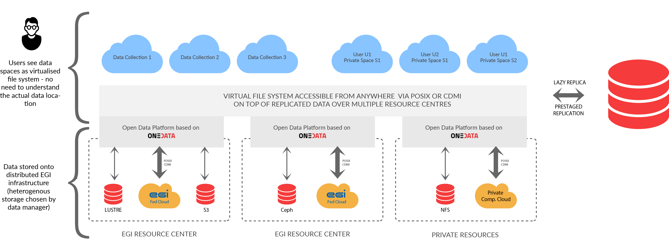
THE LANDSCAPE CHANGED BY DATAHUB

Slide 10





ONEDATA SYSTEM ARCHITECTURE
DS.
3
FUSE Client
Oneclient
Data Space 1
HTTP GUI
REST / CDMI
Onezone
FUSE Client
FUSE Client
P2P
Data Space 2
HTTP GUI
REST / CDMI
FUSE Client

Slide 11
LIVE DEMO DATAHUB IN ACTION

Slide 12
JUPITER INTEGRATION

Slide 13
fs-onedatafs - Direct access to Onedata virtual filesystem from Python
No need to create Fuse mount point on local machine
Possible to access Onedata from Docker without `--privileged` option
No need for mapping UID and GID between user applications and Oneclient
Possibly better performance without Fuse bottleneck (e.g. writing in small blocks)

Slide 14
fs-onedatafs - direct access to Onedata virtual filesystem from Python
Available as PyFilesystem plugin
Installation using pip
Requires only standard oneclient package, which will now include onedatafs.so library
Supports both Python 2 and Python 3

Slide 15

PyFilesystem
PyFilesystem is a Python library providing abstraction over various types of storages:
  https://www.pyfilesystem.org
Easy to use abstraction over filesystem operations
Allows for writing storage independent Python code
Supports several storage systems: FTP, SSH, Zip, Tar, S3, WebDAV, Dropbox, GoogleDrive, ... , and now Onedata

Slide 16
fs-onedatafs - direct access to Onedata virtual filesystem from Python
Basic usage using standard PyFilesystem API
    from fs_onedatafs import OnedataFS
    onedata_provider_host = "..."
    onedata_access_token = "...”
    odfs = OnedataFS(onedata_provider_host, onedata_access_token, force_proxy_io=True)
    odfs.listdir(‘/’)
    print(odfs.getinfo(‘/file.txt’).permissions)
    with odfs.openbin(‘/file.txt’, ‘r’) as f:
    print(f.read())
Additional Onedata specific methods available for extended metadata and data location information

Slide 17
Jupyter Notebook integration
Access to data in Onedata spaces from Jupyter
  Via fs-onedatafs Python library
Storing and reading notebooks directly in Onedata spaces without Fuse mountpoint
  Via onedatafs-jupyter plugin implementing Jupyter Contents API:https://jupyter-notebook.readthedocs.io/en/stable/extending/contents.html

Slide 18
Jupyter Notebook integration
To use the Onedata Contents Manager for Jupyter requires onedatafs-jupyter Python package
Connection parameters need to be added to Jupyter config file before starting the service
Jupyter virtual filesystem will display all contents of specific space (or it’s subdirectory)

Slide 19
Jupyter Notebook integration
Simply add the following lines to the Jupyter config (typically ~/.jupyter/jupyter_notebook_config.py):
  import sys
    sys.path.append('/opt/oneclient/lib')
    c = get_config()
    c.NotebookApp.contents_manager_class = 'onedatafs_jupyter.onedata_contents_manager.OnedataFSContentsManager'
    c.OnedataFSContentsManager.oneprovider_host = u'plg-cyfronet-01.datahub.egi.eu'
    c.OnedataFSContentsManager.access_token = u'MDAxNWxv...'
    c.OnedataFSContentsManager.space = u'/Datahub-EUDAT-Test'
    c.OnedataFSContentsManager.path = u'JupyterDemo1'
    c.OnedataFSContentsManager.insecure = True
    c.OnedataFSContentsManager.no_buffer = True
    c.OnedataFSContentsManager.force_proxy_io = True

Slide 20
FAIR - FINDABLE

Slide 21
ECRIN Use Case
Architecture

Slide 22
Architecture

Slide 23
FAIR - ACCESSIBLE

Slide 24
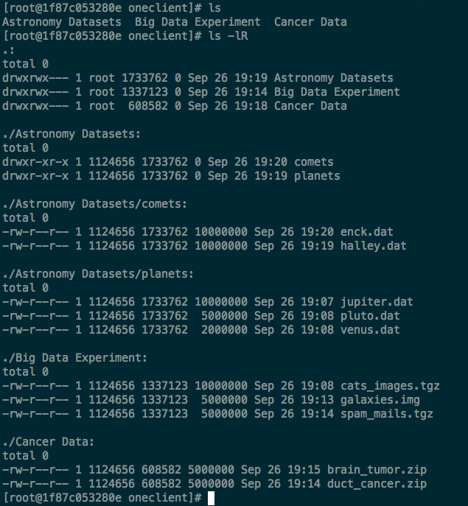
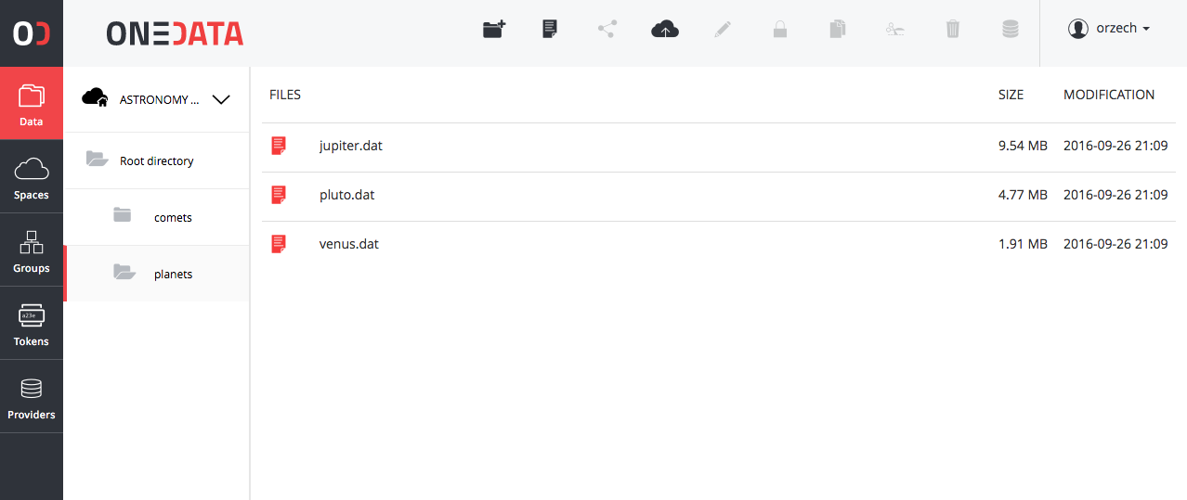
[…] BUT WE WANT POSIX
Support for most of the POSIX operations on virtual file system.
CDMI HTTP Based access
All data accessible trough in a form of unified file system mountable on VM, Grid, VM

Slide 25
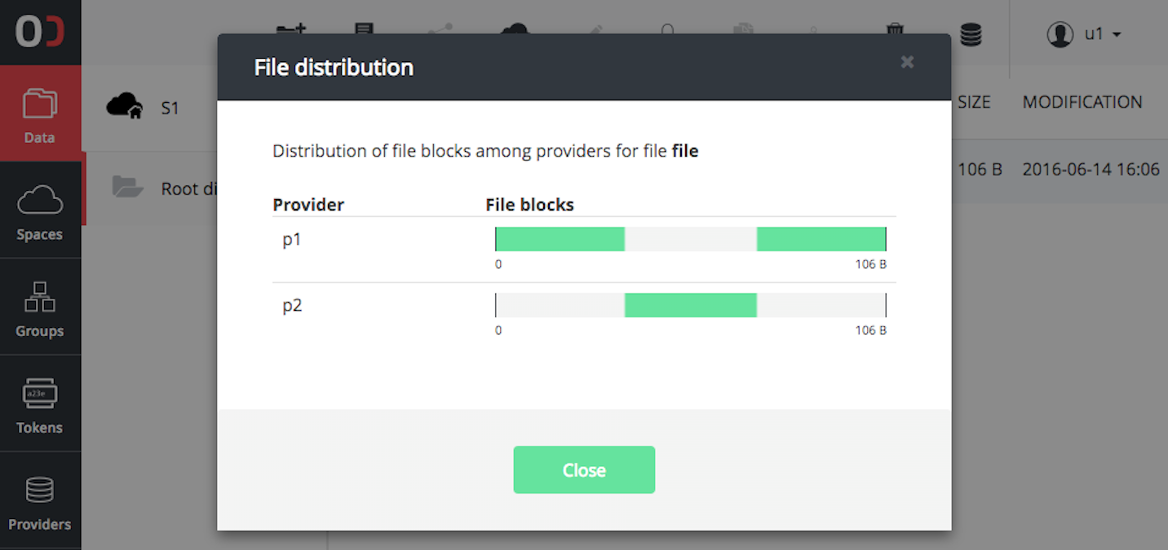
Replicas Management SIMPLIFIED
Manage files not Replicas
Files distribution level between locations is level below to the file structure
Replicas management on a chunk basis
Missing chunks delivered on the fly
API for replica management for pre-staging and implementing external data policy management

Slide 26
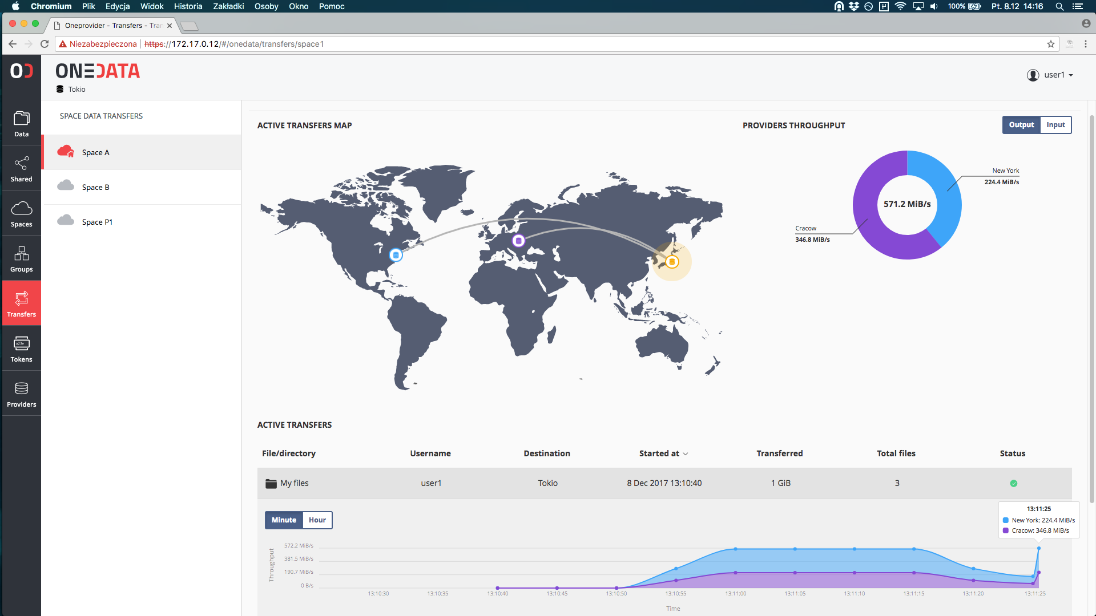
ELASTIC AND FLEXIBLE TRANSFERS

Slide 27
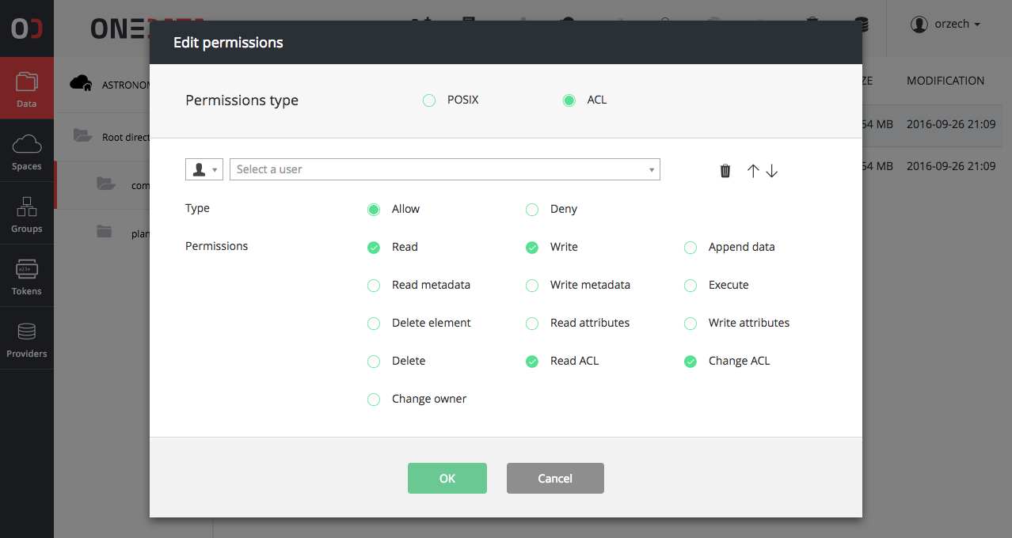
authentication and authorization
Integrated with Indigo IAM
Pluggable methods of authentication per zone
Multi level of access control
ACL on files and directories
Group management
Token based authentication (macaroons)
X.509 in prep.

Slide 28
FAIR - INTEROPERABLE

Slide 29
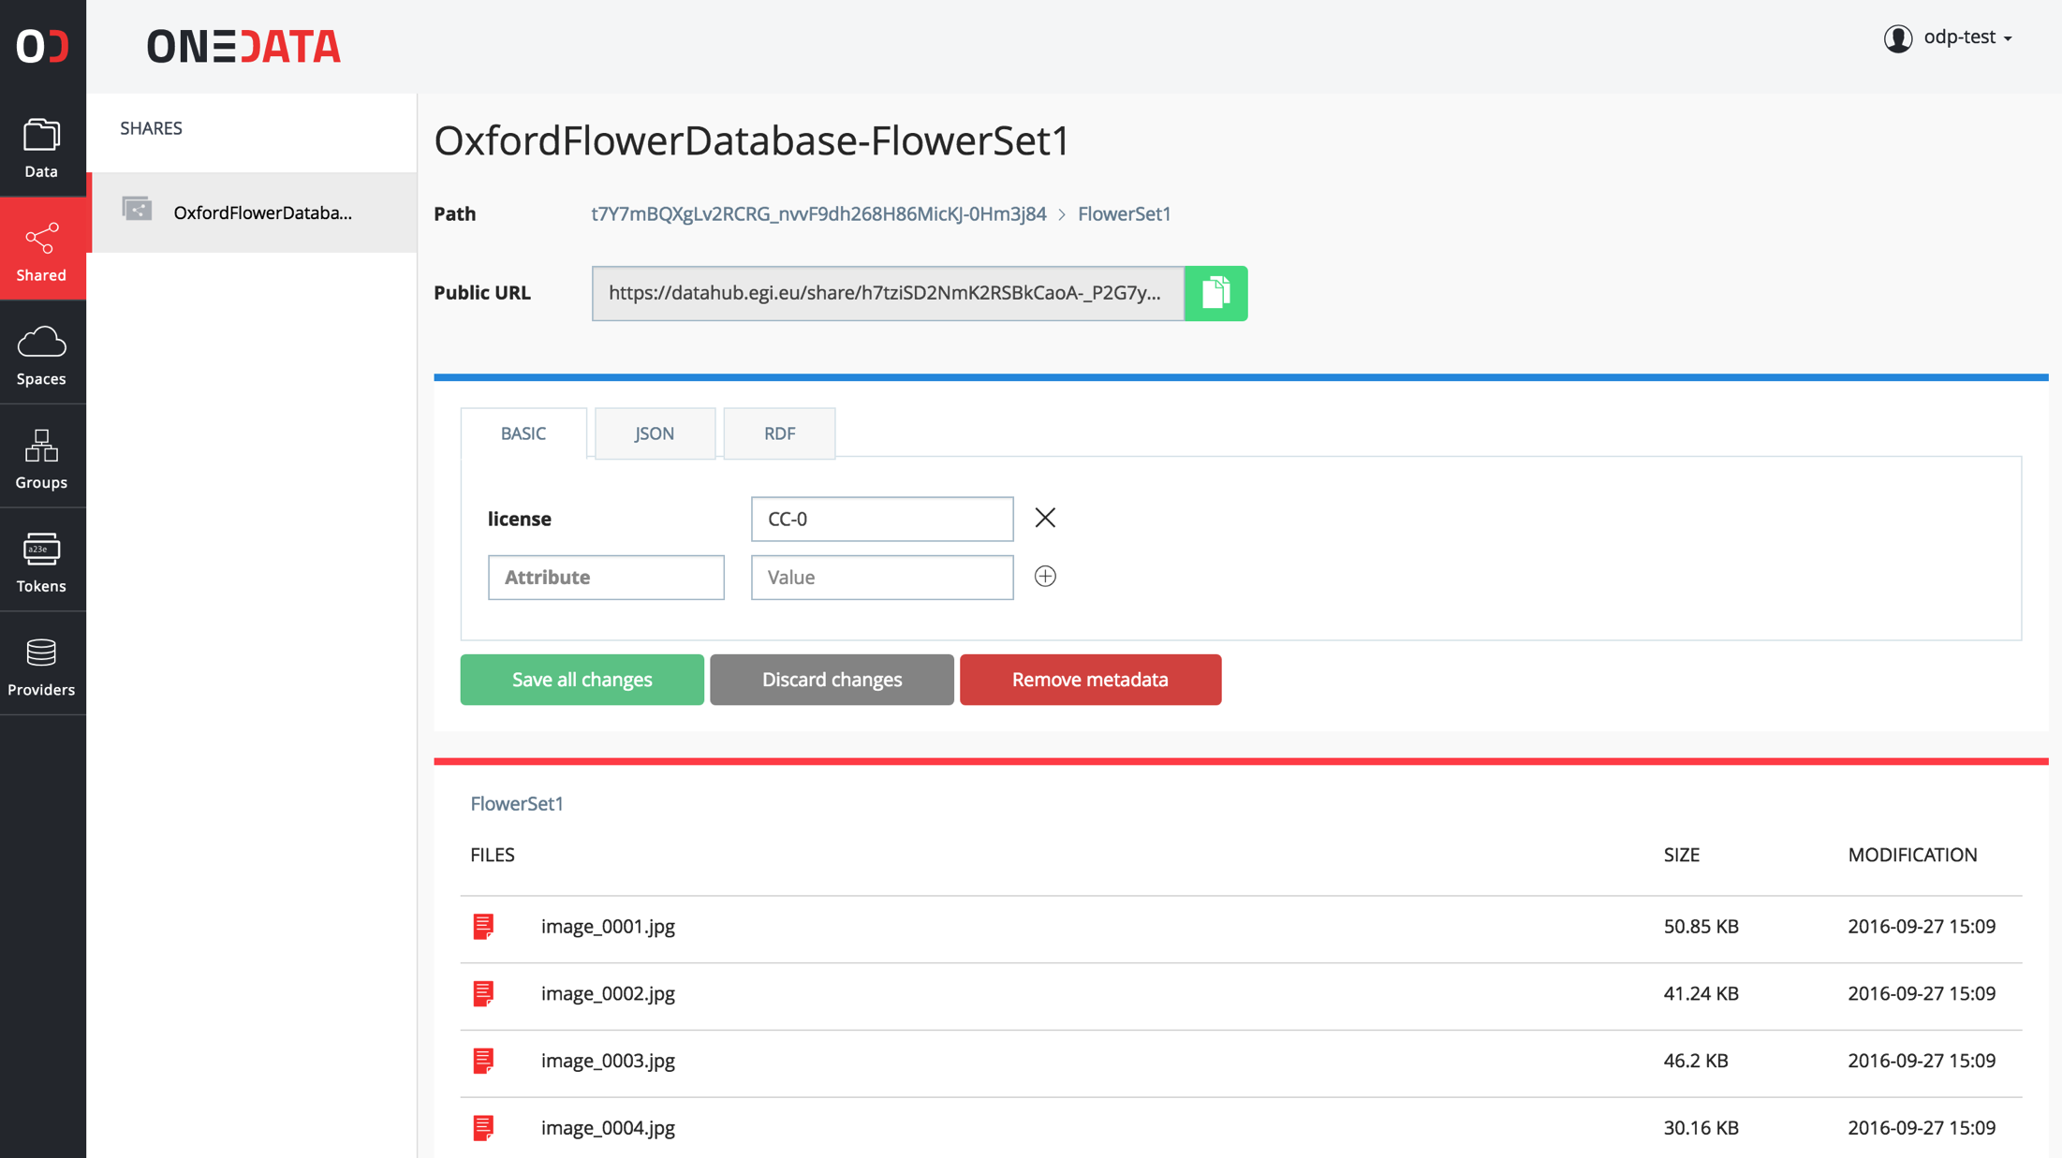
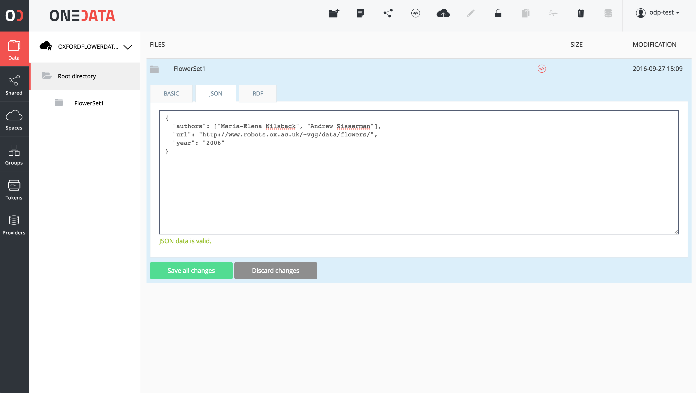
ADVANCED METADATA SUPPORT
Metadata can be attached to resources (files, folders) in simple key-value form, JSON or RDF
Users can define custom indexes over the metadata in order to filter their data collections
Metadata can be used for Open Data collections when published

Slide 30
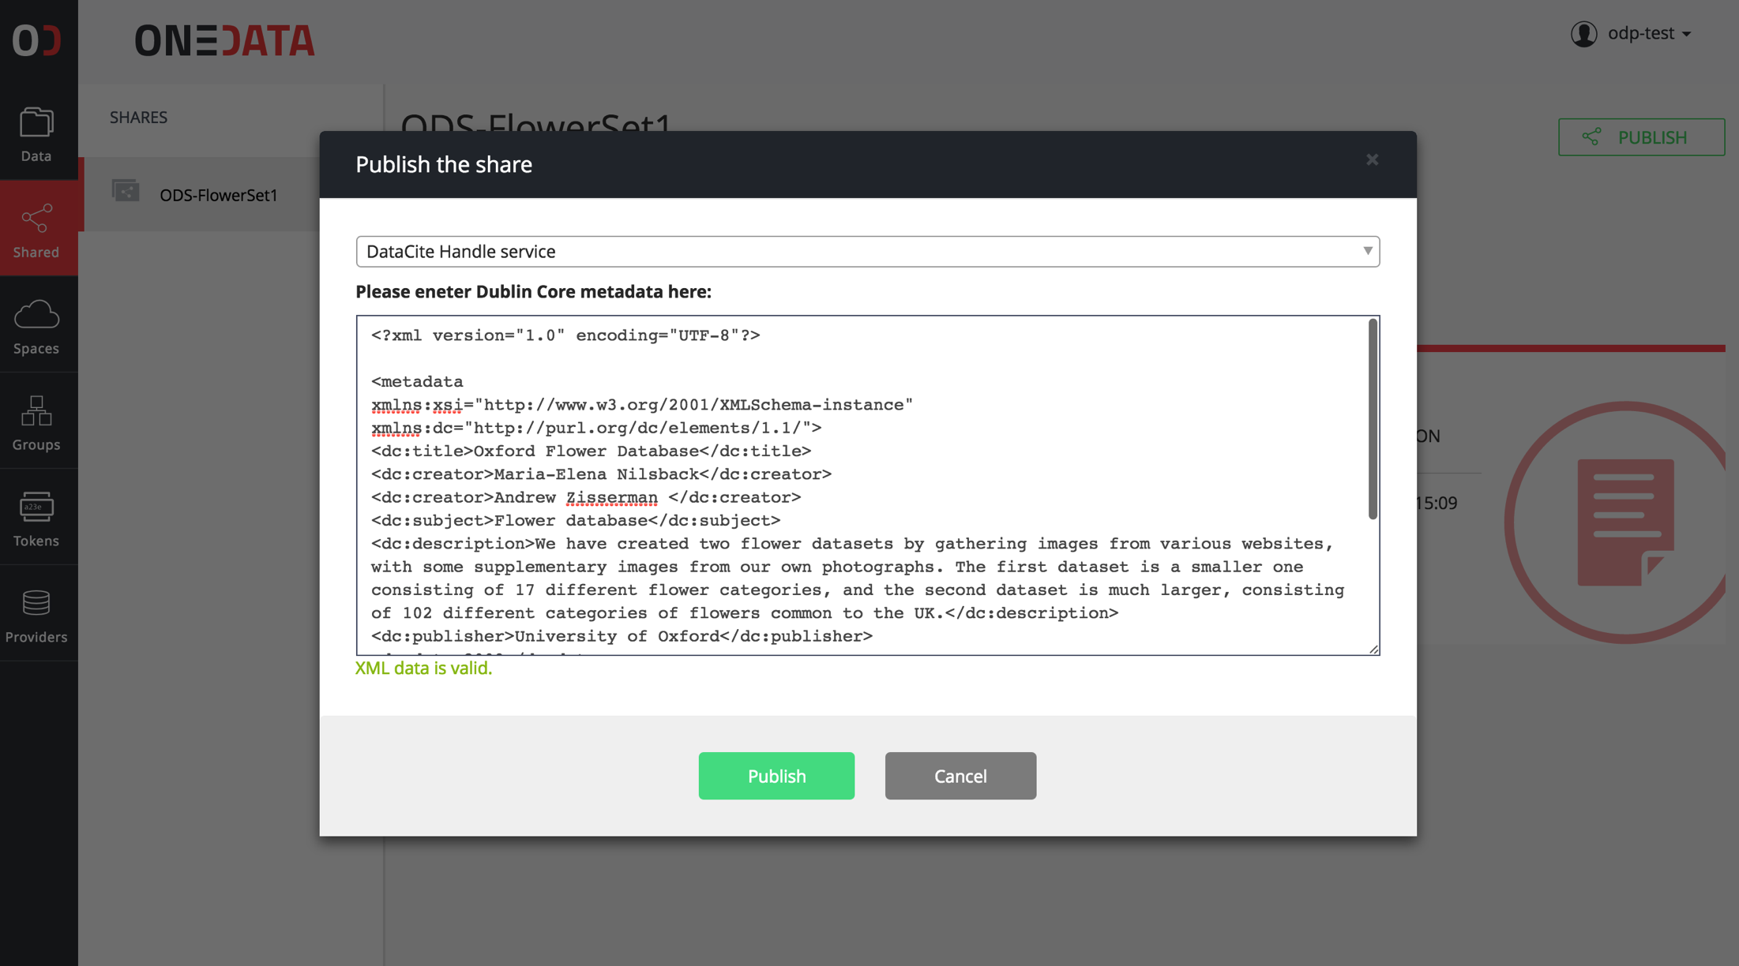
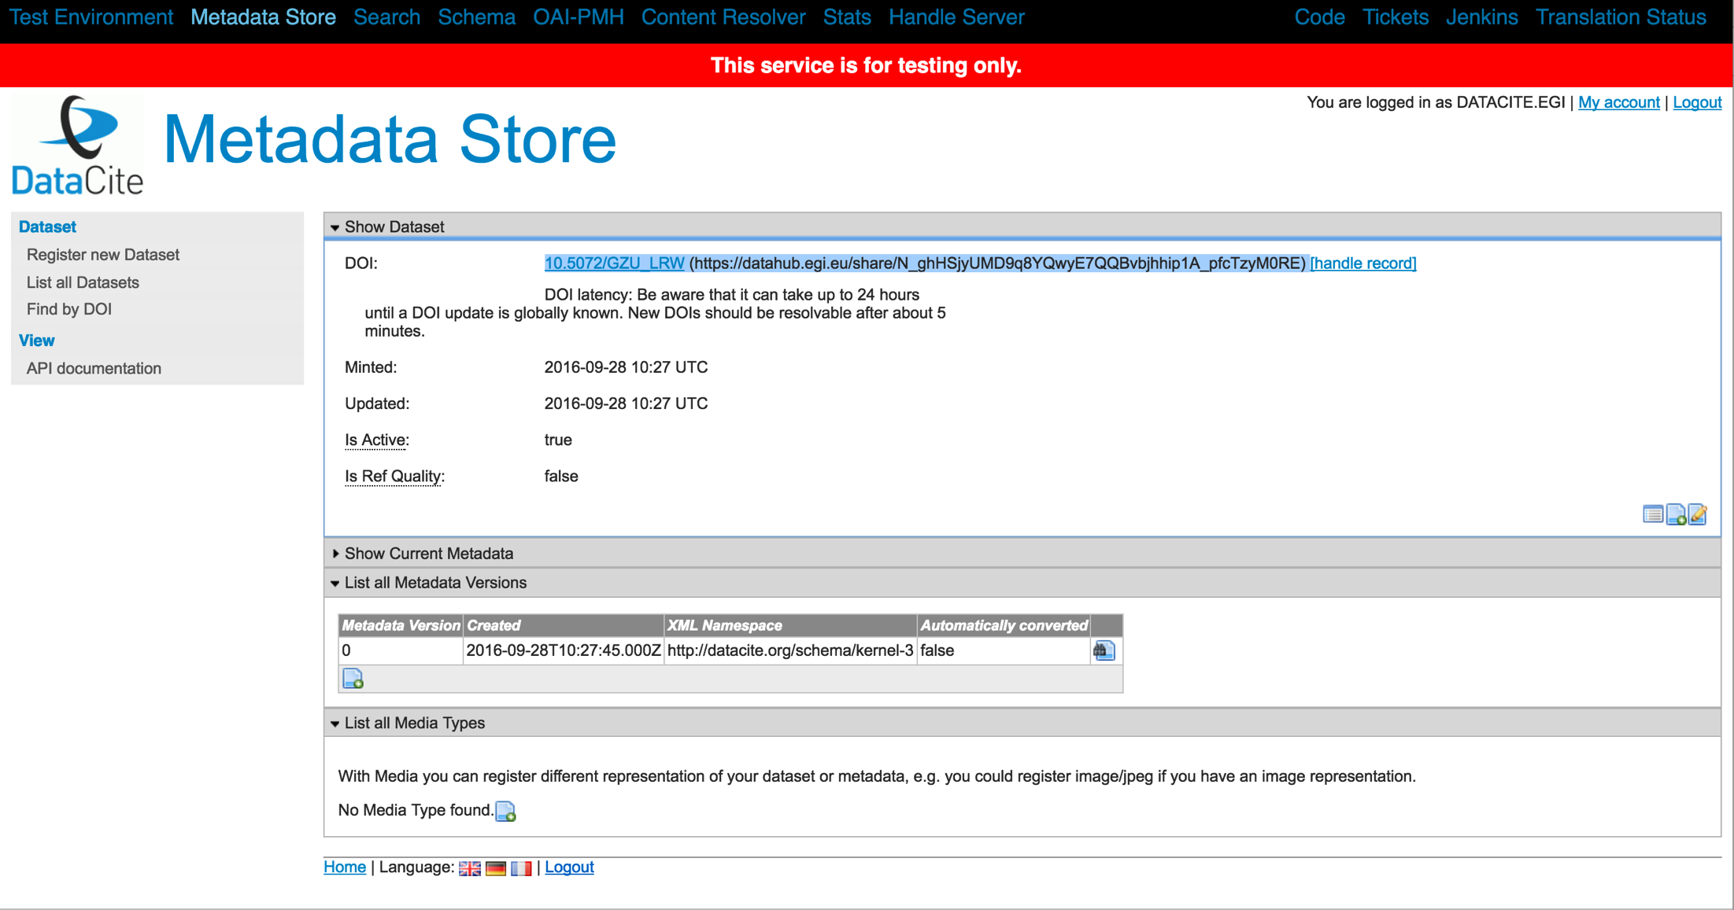
DOI REGISTRATION
Onedata supports Handle system-based identifier services (e.g. DOI and PID)
Any user can register such service, provided they have a valid account with the registrar
Each file or collection can be accessed directly using DOI identifier

Slide 31
SUMMARY

Slide 32
ONEDATA UNIFIED DATA
MANAGEMENT SERVICE
Sharing Existing
Data Sets
Hierarchical
Groups Synced
with IdPs
DOI/Handle
Minting
Adhoc
Grouping
WEB
GUI
My Data
External
Systems
No-Barrier
Data Sharing
Storage
Heterogeneity
Unified
HTTP
CDMI
API
Policy
Mgmt.
Multi-level
Scalability
REST
API
External
Systems
No Data Lock-in
Open Data Sharing
Many IdPs
Migration
between
Locations
LONG
POLLING
API
Multiple Replicas
Decentralization
Decoupled
Collections
Legacy
Applications
POSIX FILE
SYSTEM
Metadata Annotation
Fine Grain
Access Control
Other
API
Data
Discovery
Data Caching
Virtual
Filesystem
Distributed
Data

Slide 33
FEEDBACK PLEASE
https://www.surveymonkey.com/r/EOSC-hub_week_02

