Slide 1
EGI High-Throughput Compute

Slide 2
Content
Motivation and driving consideration about the service
Service architecture and interfaces: overview
How the user can access the service
E.g.: REST, GUI, CLIs, etc.
Service options and attributes
Acceptable Usage Policy (AUP)
Access policy and business model
Use cases
Documentation/tutorial/information

Slide 3
Motivation
“Execute thousands of computational tasks to analyze large datasets”
The EGI High-Throughput compute (HTC) provides users with the capability to access large amounts of computing resources, and to submit hundreds or thousands of computational tasks.
The EGI HTC Compute service is provided by a distributed network of computing centres, accessible via a standard interface and membership of a virtual organisation.
EGI offers more than 1,000,000 cores of installed capacity, supporting over 1.6 million computing jobs per day.

Slide 4
Main features
Access to high-quality computing resources.
Integrated monitoring and accounting tools to provide information about the availability and resource consumption.
Workload and data management tools to manage all computational tasks.
Large amounts of processing capacity over long periods of time.
Faster results for your research.
Shared resources among users, enabling collaborative research.

Slide 5
Generic service architecture interfacing directly with CEs
User Client (User Interface)
Job Sandbox
Worker node
CE node (ARC CE/HTCondor-CE)
(Note: in the case of DIRAC WMS, the CEs are behind the WMS)

Slide 6
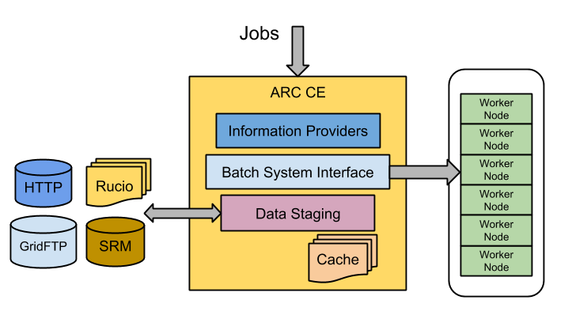
ARC CE Architecture

Slide 7
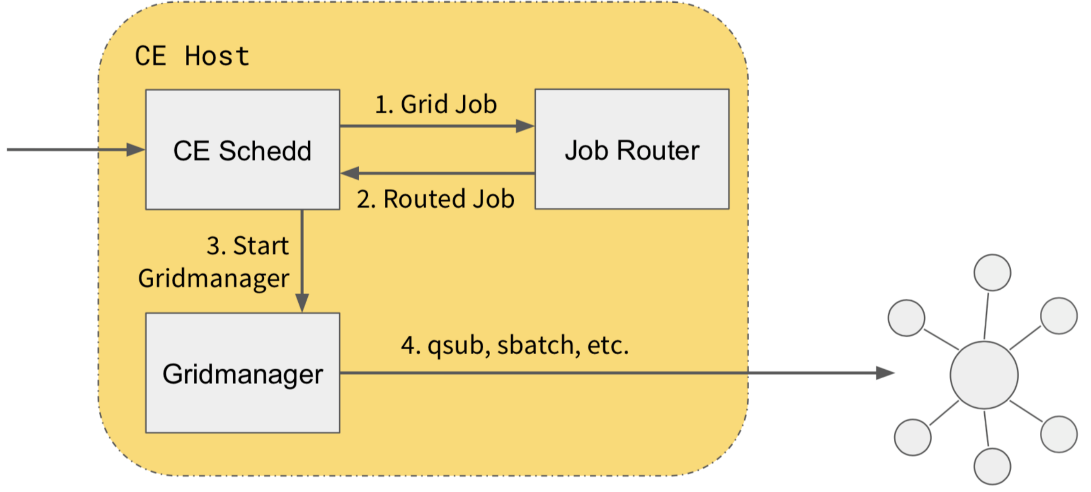
HT-Condor CE Architecture
Local batch
system

Slide 8
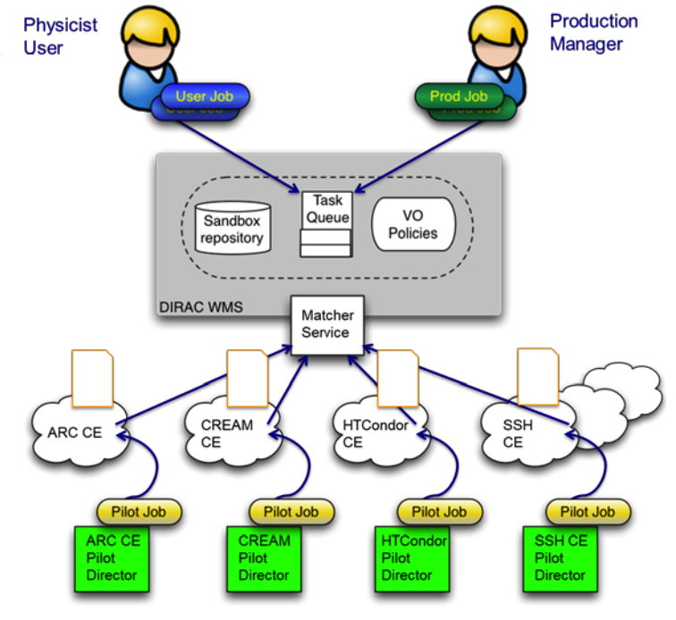
DIRAC WMS Architecture
DIRAC4EGI instance: https://dirac.egi.eu/DIRAC/

Slide 9
Service access
ARC User Interface (UI):
http://www.nordugrid.org/documents/arc-ui.pdf
HTCondor-CE:
https://opensciencegrid.org/docs/compute-element/install-htcondor-ce/
Dirac WMS:
https://dirac.readthedocs.io/en/latest/AdministratorGuide/Systems/WorkloadManagement/
Notes:
https://agenda.ct.infn.it/event/895/
https://buildmedia.readthedocs.org/media/pdf/cream-guide/latest/cream-guide.pdf
https://cream-guide.readthedocs.io/en/latest/User_Guide.html

Slide 10
Service options
Service Options
Base High-Throughput Compute:
It allows the execution of large numbers of independent or loosely coupled computing tasks. Limited parallel and multi-thread computing can be supported as well.
MPI High-Throughput Compute:
It allows parallel computing, with support of MPI protocol and libraries.

Slide 11
Service attributes
Service attributes
Number of CPU Hours
Guaranteed Number of CPU cores
Amount of RAM per CPU core (GB)
Parallelism (Threads)
Access type: Opportunistic or Reserved
Start of service (date) and duration (days)
Other Technical Requirements

Slide 12
Acceptable Usage Policy
EGI AuP:
https://documents.egi.eu/document/2623
Further VO-level AuPs may also apply

Slide 13
Access policies and Funding models
Access policies:
Policy-based
Market-drive
Payment model:
Sponsored use for policy-based access (free for a certain quota)
Pay-as-you-go for market-driven access
Prices available at: https://wiki.egi.eu/wiki/EGI_Pay-for-Use_PoC:Service/Price_Overview

Slide 14
HTC use cases
Online PDF
Online PDF

Slide 15
More HTC use cases
Clean methane from recycled carbon dioxide [Chemistry]
Studying the atmospheric composition in Bulgaria [Atmospheric Sciences]
Satellite observations help to monitor air quality in China [Atmospheric Sciences]
Self-fertilization can improve resilience to extinction [Biodiversity]
Old coal heaps can be valuable ecosystems [Biodiversity]

Slide 16
EOSC-hub Service Catalogue https://www.eosc-hub.eu/catalogue

