Slide 1
EGI Online Storage
Dissemination level: Public

Slide 2
Content
Motivation and driving consideration about the service
Service architecture and interfaces: overview
How the user can access the service
E.g.: REST, GUI, CLIs, etc.
Service options and attributes
Acceptable Usage Policy (AUP)
Access policy and business model
Use cases
Documentation/tutorial/information

Slide 3
Motivation
Different service options to allow :
Access data through different standard protocols and replicate data across different providers to increase fault-tolerance.
Assign global identifiers to files
Access highly-scalable storage from anywhere
Control the data sharing
Organise data using a flexible hierarchical structure
Extends storage resources for Compute instances

Slide 4
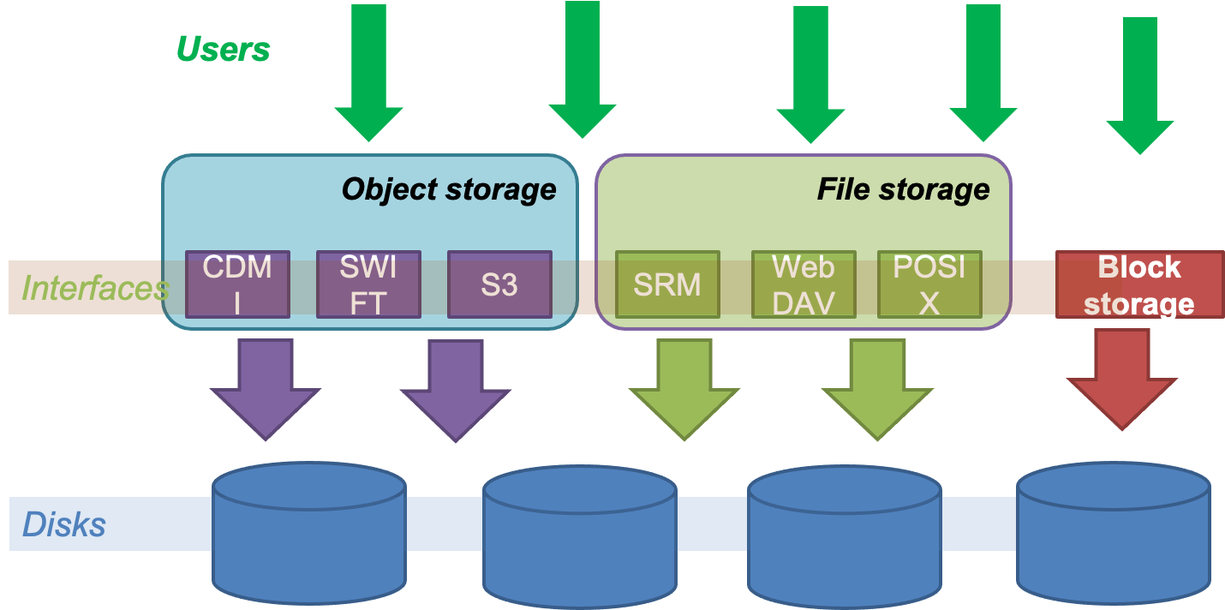
Architecture and interfaces

Slide 5
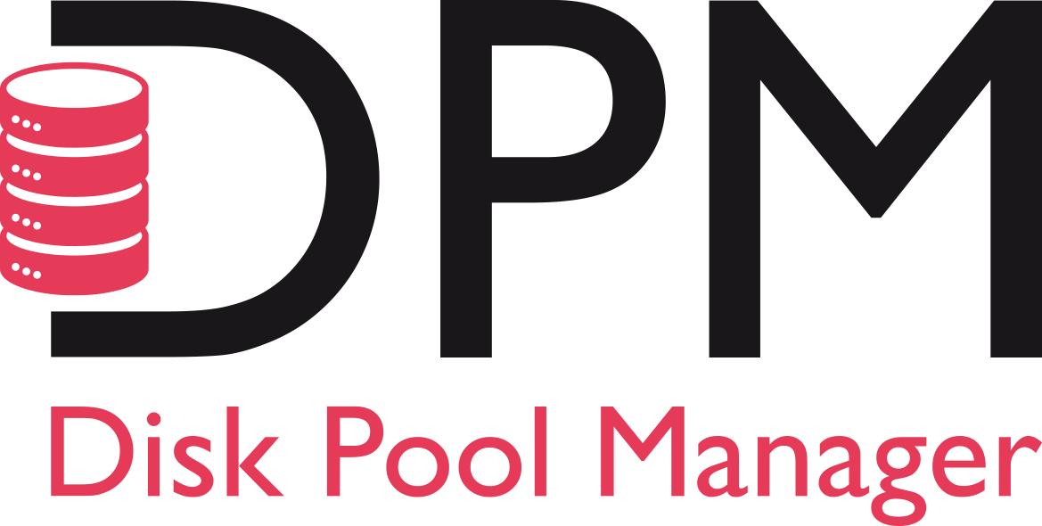
Service architecture and interfaces
The service comprices 3 main options: File Storage, Block Storage and Object Storage.
File Storage:
Highly scalable storage system accessible from anywhere allowing to easily share data through different standard interfaces.
Technology: DPM, dCache, StoRM
Interfaces: SRM, HTTP/WebDAV, XRootD, GSIFTP, CDMI

Slide 6
Service architecture and interfaces
Block Storage:
block-level storage solution that allows to expand the storage capacity of instances in the EGI Federated Cloud.
increase storage without increasing the size or capacity of the instance or by provisioning new ones; delete servers, keeping data intact and ready for the next time is need it.
Technology: Openstack Cinder
Interfaces: POSIX for access, OCCI and Openstack CLI for management

Slide 7
Service architecture and interfaces
Object Storage:
Manages data as objects. Each object includes the data itself, a variable amount of metadata, and a globally unique identifier.
Cloud object storage allows relatively inexpensive, scalable and self-healing retention of massive amounts of unstructured data
Technology : OpenStack Swift, CEPH
Interfaces: S3, Swift, CDMI

Slide 8
Service access
File Storage
The service exposes standard interface for data access that can be contacted via CLIs and libraries
For grid based protocols ( SRM, gsiftp, Xrootd) the gfal2 library and CLI is the recommended choice
For HTTP/Webdav many known clients are available, like curl
Block Storage
Storage is accessible via POSIX interface.

Slide 9
Service access
Object Storage
for Openstack Swift implementation, the OpenStack CLI can be used to access objects and containers
for Object storage instances exposing the CDMI and S3 protocols any CDMI and S3 command line client can be used
Many libraries are also available for programmatic access via S3 , CDMI and Swift protocols

Slide 10
Service options and attributes
File Storage
Storage capacity [TB]: [1, 5, 10, other]
Technology: [DPM, dCache, StoRM]
Special requirements: e.g. performance, close to the computational resources
Object Storage
Storage capacity [TB]: [1, 5, 10, other]
Interfaces: [CDMI, S3, Swift]
Special requirements: e.g. performance, close to the computational resources

Slide 11
Service options and attributes
Block Storage
Storage capacity [TB]: [1, 5, 10, other]
Special requirements: e.g. performance, close to the computational resources

Slide 12
Acceptable Usage Policy
No dedicated AUP and Condition of Use exist
Existing EGI-wide documentation will apply

Slide 13
Access policies and Funding models
Access policies:
Policy-based,
Wide-access,
Market-driven
Payment model:
Sponsored (free for a certain quota)
Wide-access
Market-driven

Slide 14
Featured use cases - File Storage
File storage can be used for storing and accessing files on the infrastructure as input to EGI HTC computations
The EGI Workflow Management systems ( DIRAC) is able to access files stored in File Storage instances via different protocols, and schedule the computation in order to be executed close to where the input files are stored
By accessing input files close to computing resources the overall efficiency of data intensive computations increase significantly.

Slide 15
Featured use cases - Block storage
A block-level storage solution allows to expand the storage capacity of VM instances in the EGI Federated Cloud and offers the lowest possible latency for applications
Data are kept intact when deleting VMs if stored in block storage therefore is highly recommended

Slide 16
Featured use cases - Object Storage
Object Storage can be used for storing massive amount of unstructured data within the EGI Federated Cloud
Object storage is ideal for applications that need durability, availability and scalability for data storage
The main uses cases are:
Backups and Data Archive, AI and ML , Cloud Native applications

Slide 17
Documentations/Links
https://docs.egi.eu/users/online-storage/
https://www.egi.eu/services/online-storage/
https://marketplace.egi.eu/34-online-storage

