Slide 1
Check-in
Identity and Access Management solution that makes it easy to secure access to services and resources

Slide 2
Content
Motivation and driving consideration about the service
Service architecture and interfaces: overview
How the user can access the service
E.g.: REST, GUI, CLIs, etc.
Service options and attributes
Acceptable Usage Policy (AUP)
Access policy and business model
Use cases
Documentation/tutorial/information

Slide 3
Motivation
Single sign-on to services through eduGAIN, social media and other institutional or community-managed identity providers
Single sign-on to services through eduGAIN, social media and other institutional or community-managed identity providers
Only one account needed for federated access to multiple heterogeneous (web and non-web) service providers using different technologies (SAML, OpenID Connect, OAuth 2.0, X509)
Identity linking enables access to resources using different login credentials (institutional/social)
Association of assurance information to each authenticated identity for expressing the level of trust in the identity assertions
Aggregation and harmonisation of authorisation information (VOs/groups, roles, assurance) from multiple sources

Slide 4
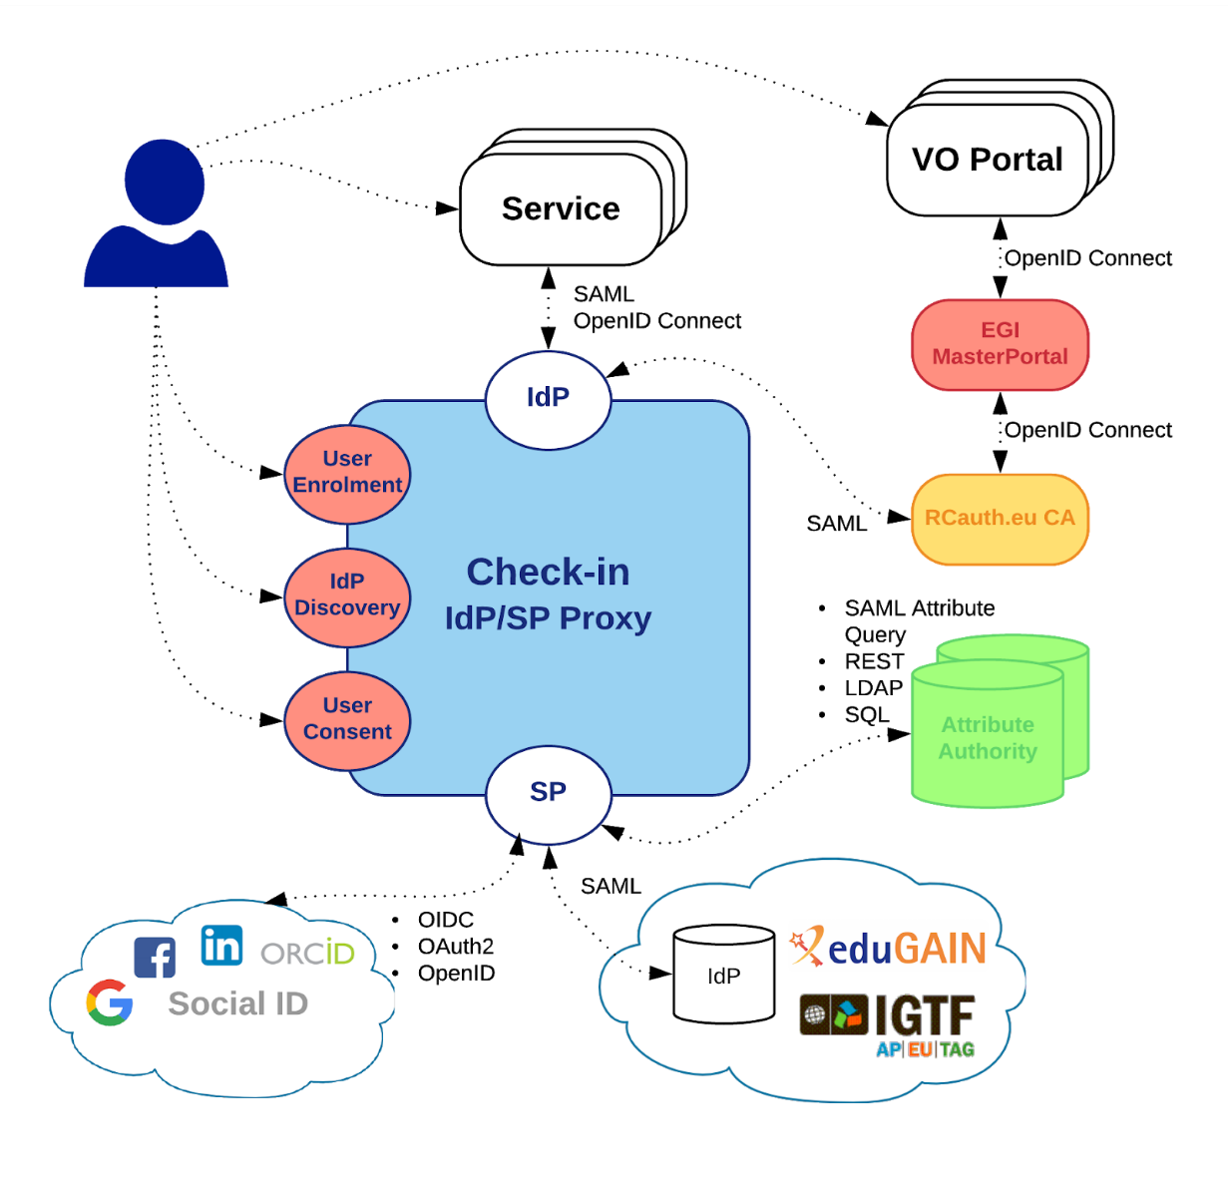
Service architecture and interfaces
Check-in is an implementation of the AARC blueprint architecture
Single point of integration for Identity Providers (IdPs) and Service Providers (SPs)
Registered in eduGAIN as an SP complying with REFEDS Research & Scholarship and Sirtfi
All connected end-services can have one statically configured IdP
No need to run an IdP Discovery Service on each end-service
All connected end-services get consistent/harmonised user identifiers and accompanying attribute sets from different IdPs/AAs that can be interpreted in a uniform way for authorisation purposes

Slide 5
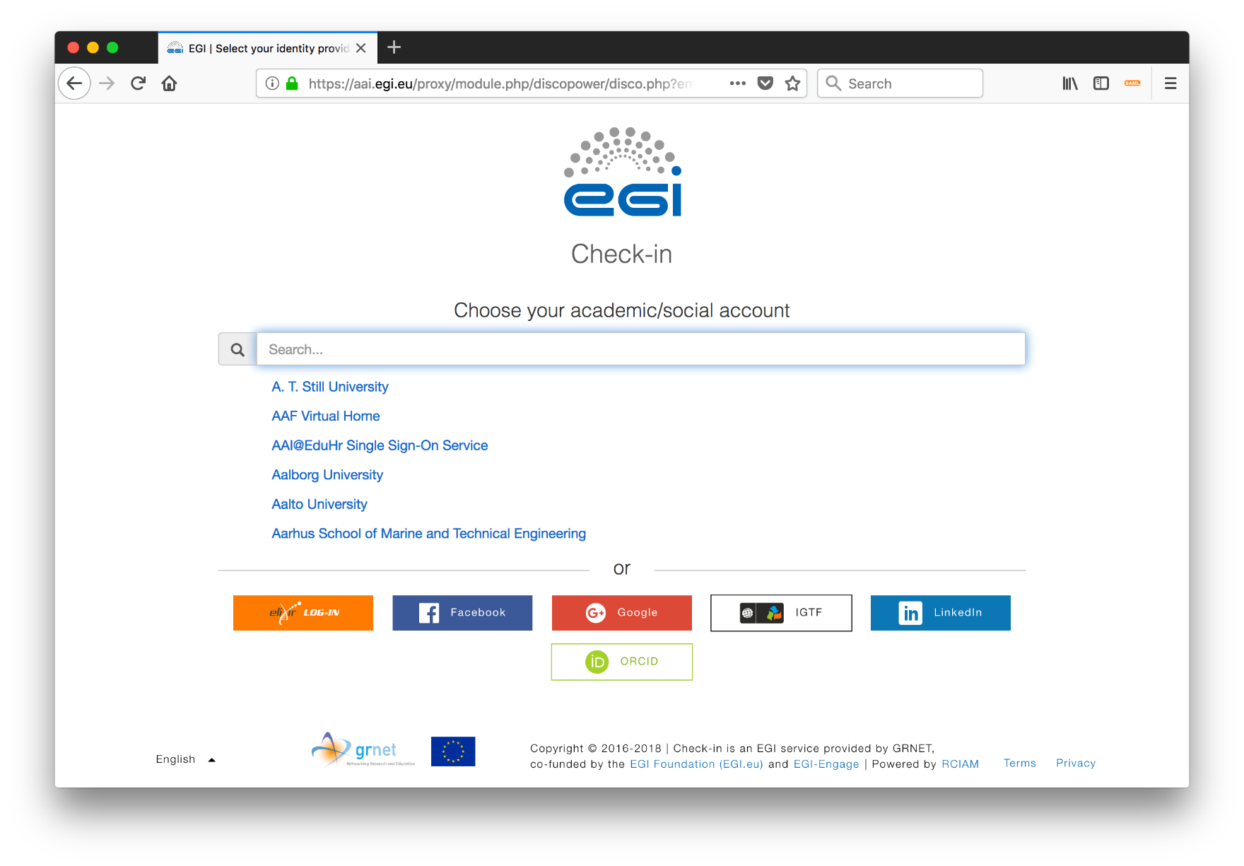
Service access – IdP Discovery

Slide 6
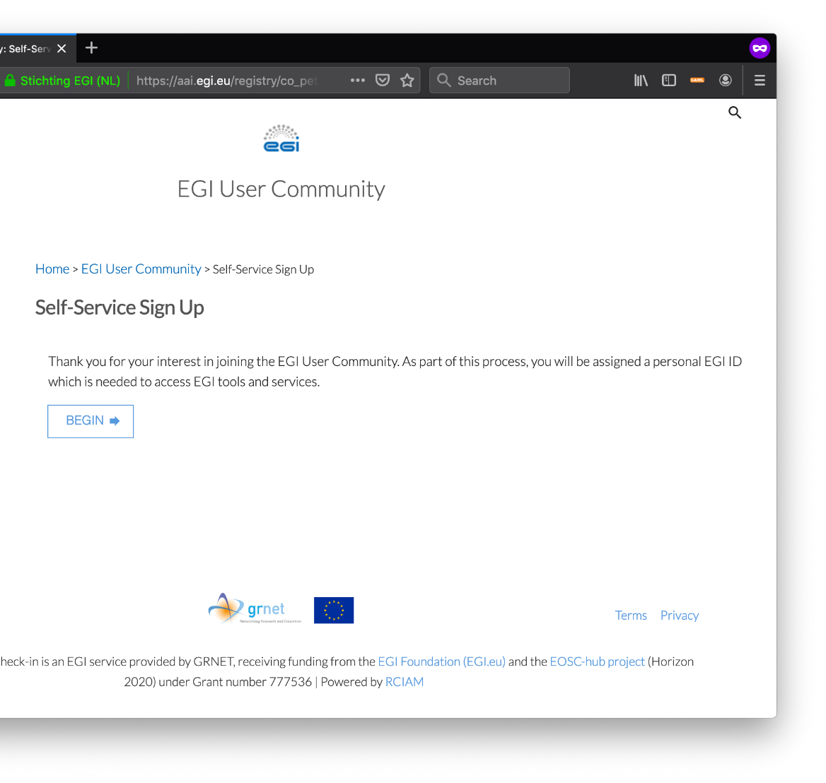
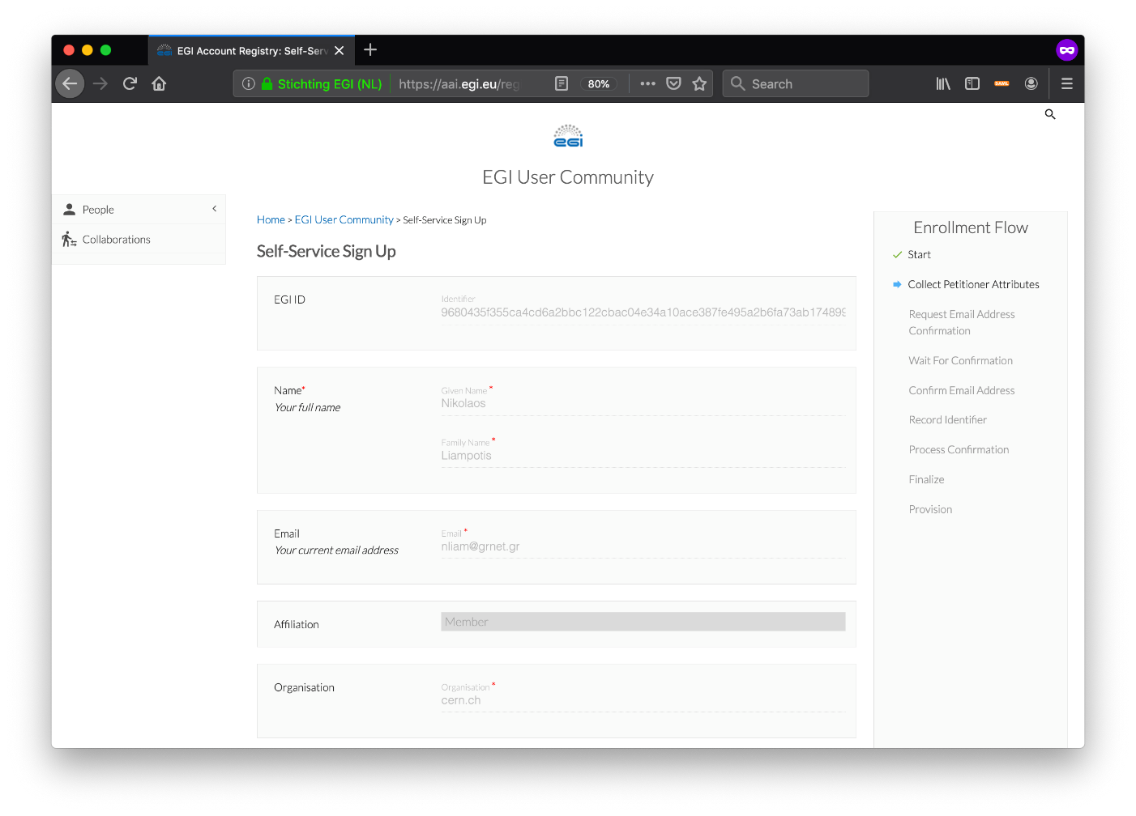
Service access – User enrollment

Slide 7
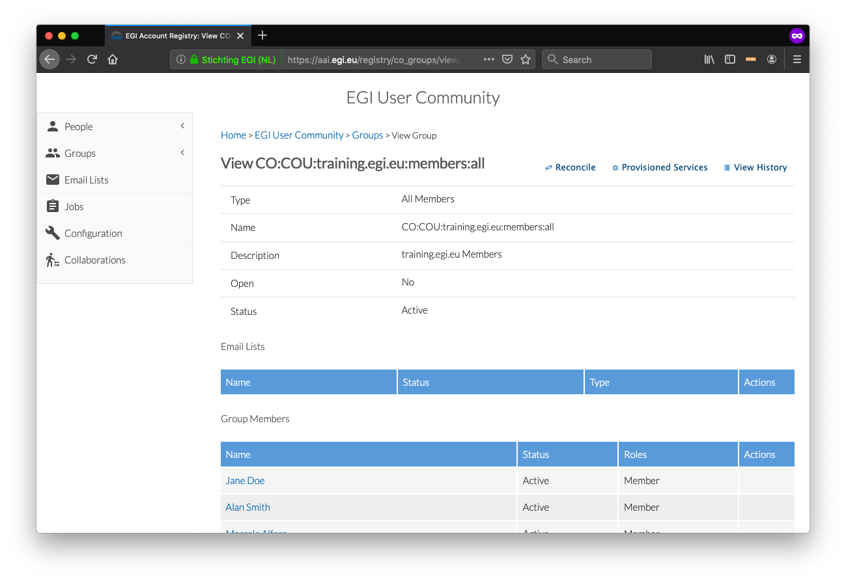
Service access – Group management

Slide 8
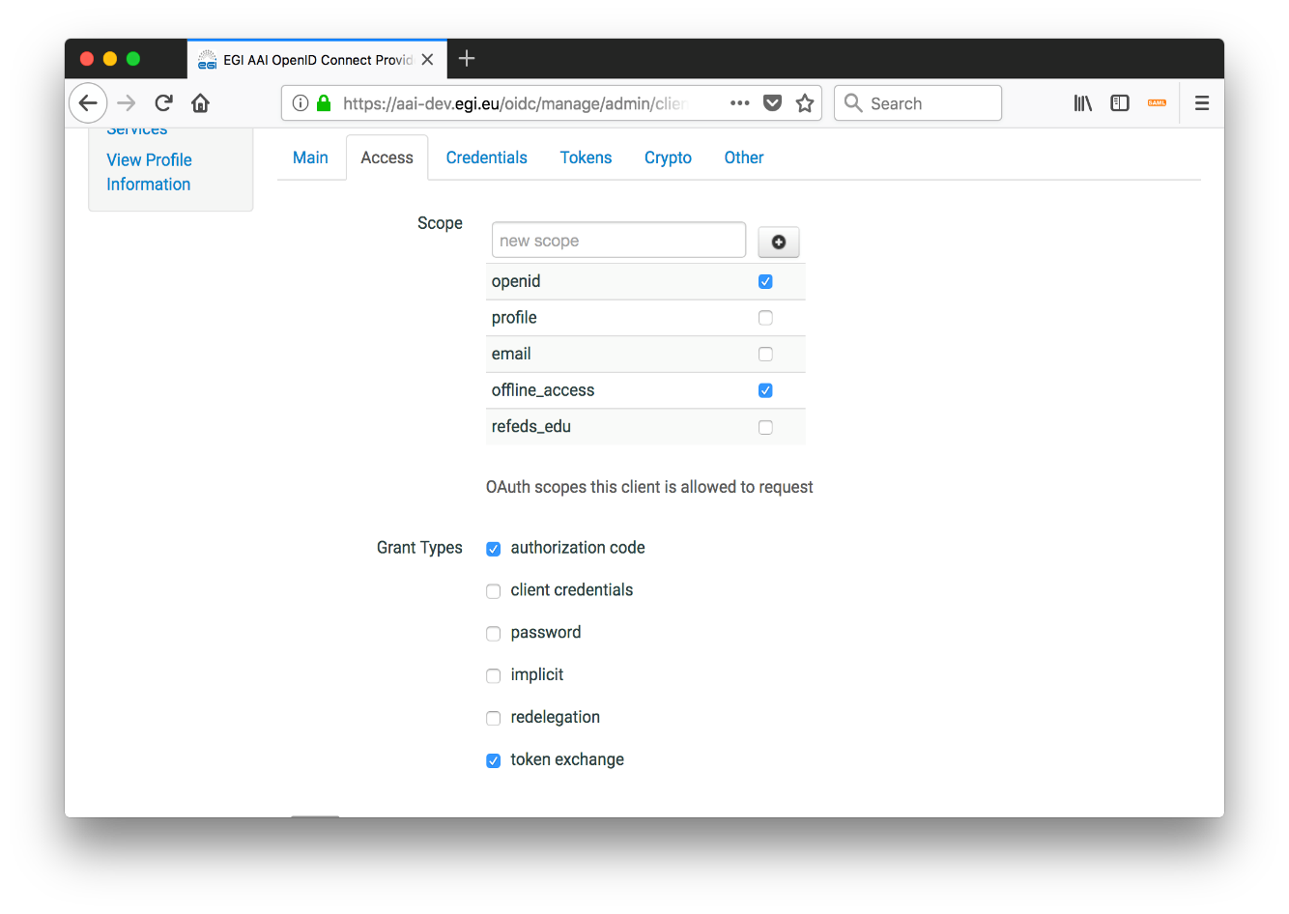
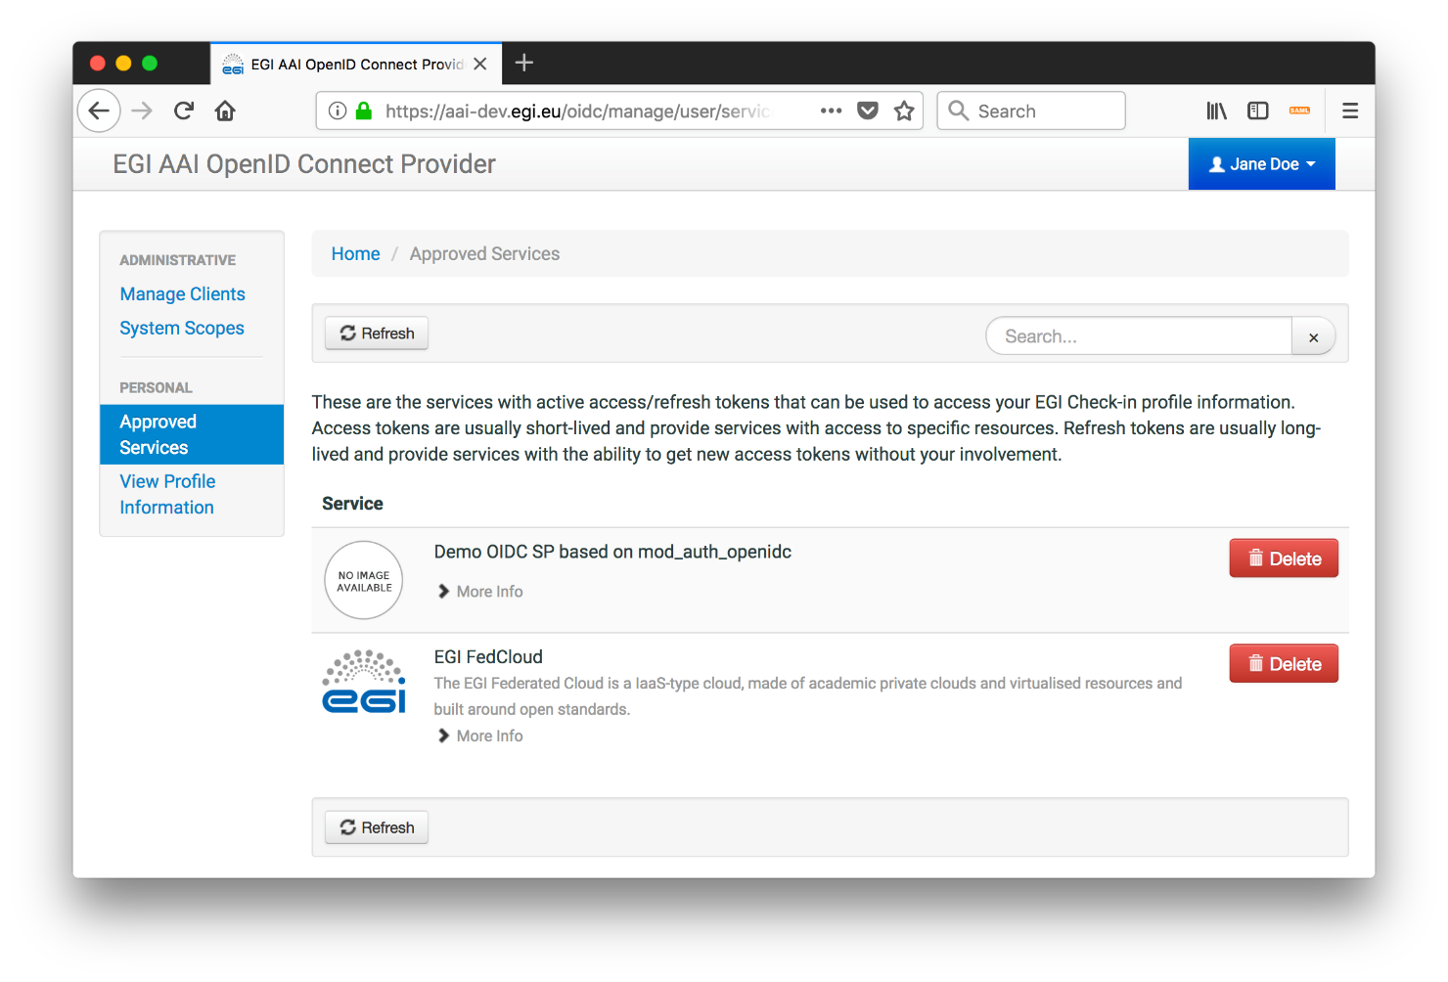
Service access – Non-web use cases & delegated access via OpenID Connect/OAuth 2.0
Friendly UI for managing/testing OpenID Connect/OAuth 2.0 clients
Provides overview of OpenID Connect/Oauth 2.0 services authorised to access their identity
Allows users to see the specific permissions (e.g. read email, offline access, etc.) granted to each service
Enables users to manage access/refresh tokens associated with each service:
Revoke access for individual tokens or service as a whole
Retrieve access/refresh tokens to be used for federated access to CLI tools/APIs
Multipath delegation via OAuth 2.0 Token Exchange
Support for attenuation of rights/scopes
Device code flow (experimental)

Slide 9
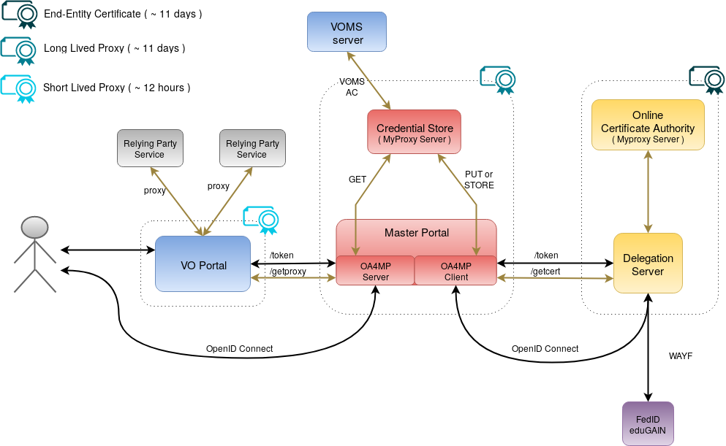
Service access – Non-web use cases & delegated access via RCauth Online CA issued certificates
Check-in has been integrated with the production RCAuth.eu Online CA for allowing users to retrieve X.509 proxy certificates using their federated credentials
Master Portal retrieves end-entity certificate from RCauth.eu
Long-lived proxy certificate stored in backend MyProxy server
Short-lived proxies provided via:
Science Gateways via OIDC (so-called VO-portals)
users e.g. via SSH key authentication
RCauth Online CA

Slide 10
Service options and attributes
Service option 1 – Check-in as community AAI: Manage your users and enable multiple federated authentication sources using different technologies
Authentication: Check-in enables users to re-use their academic and social accounts
Authorisation: Check-in manages community/group membership information to control access to services
Built-in group management tools for creating and managing a Virtual Organisation (VO) and (sub)groups, adding and removing users, and managing user consent and the VO acceptable usage policy
Service option attributes:
Deployment type: shared or dedicated
Authentication options:
eduGAIN
ORCID
Google
Facebook
LinkedIn
IGTF X.509 digital certificates
Other identity provider managed by the community
User registration and group management service operated by:
community, or
EGI
User registration & group management:
COmanage
Perun
VOMS
Other group management technology that best fits the community’s requirements

Slide 11
Service options and attributes
Service option 2 – Check-in for services or resource providers
Check-in acts as an identity provider proxy. Service providers can configure it as a normal SAML or Open ID Connect identity provider and let Check-in handle external identity providers. Check-in will provide all the required authentication and authorisation information to service providers in a single assertion.
Advantages for service providers:
Users can use their existing accounts from the eduGAIN identity provider interfederation, social media, and ORCID
Your service can become available to new identity providers added to Check-in
Users can link different accounts and access you service with a single user identifier
All required information for handling user authentication and authorisation including: persistent unique user identifier, GOCDB roles, Virtual Organisation/group membership information, Assurance, X.509 certificate DN
Service option attributes:
AAI protocol: OIDC or SAML
Communities allowed to access your resources: All or custom list of communities

Slide 12
Service options and attributes
Service option 3 – Check-in as a Bridge to EGI services & resources
Community operating its own AAI connected to Check-in as an Identity Provider Proxy for allowing its users to access EGI services & resources
Service option attributes:
AAI protocol for connection with Community AAI Identity Provider Proxy: OIDC or SAML
EGI services to be connected: All or custom list of services

Slide 13
Acceptable Usage Policy
https://aai.egi.eu/ToU.html

Slide 14

Access policies and Funding models
Multi-tenant service (aai.egi.eu)
All the standard Check-in authentication options (academic & social)
Community management using COmanage or Perun
Basic customisation of user-facing interfaces (e.g. community-specific themes for enrolment flows, group management)
Basic customisation of AAI proxy behavior
Enables access to services and resources offered by the European Open Science Cloud
Suited for and freely available to small and medium sized communities
Dedicated service (individual components or AAI service as a whole)
All the features of the multi-tenant (shared) service, plus:
Full customisation of user-facing interfaces: IdP discovery service, enrolment, group membership UI
Full customisation of AAI proxy behaviour (e.g. attribute aggregation rules, service entitlements/capabilities)
Integration with community-specific identity providers and/or attribute authorities

Slide 15



Featured use case – For communities in need of a ready-to-use group management solution
Communities that do not operate their own group management service can leverage the group management capabilities of the Check-in platform to:
Avoid overhead of deploying a dedicated group management service
Allow authorised group admins to manage the information about their users independently
Enable easy and secure access to resources offered by EGI and other infrastructures participating in EOSC
eduGAIN
Social
EGI CheckIn
Virtual Organization
Service
EOSC Infrastructure
Service
Use Case: Training and Long Tail of Science communities

Slide 16
Featured use case – For communities operating their own AAI
Social
Community’s AAI connected to Check-in as an IdP Proxy to allow its users to access EGI services & resources
Community can access EGI services without changing their users’ authentication workflow
eduGAIN
Community IdP
Community AAI
EGI Check-in
EGI Infrastructure
Use Case: ELIXIR Research Infrastructure - Check-in allows ELIXIR users to use their ELIXIR IDs to interact with relevant EGI services (Cloud, Configurations database, Applications on Demand)
Service
Service

Slide 17
Documentations
Usage guide
Integration guide for service providers
Integration guide for identity providers
Frequently Asked Questions

