Slide 1
Feedback – Service Provider Survey
Distributed to onboarded Service Providers during May
Anonymous feedback allowed, didn’t ask for onboarding date.
9 responses (3 anonymous)
Questions:
What is you overall experience in participating with the EOSC? (1-5)
What do you hope to get to get out of participation with EOSC? This can be either now or in future as it further develops (FREETEXT)
What is your experience of the onboarding process itself? (1-5)
In your opinion, what is the most urgent area for improvement for EOSC? (FREETEXT)
Please provide any further comments or feedback (FREETEXT)

Slide 2
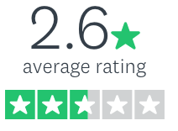
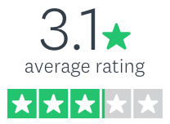
Feedback – Service Provider Survey Results
What is you overall experience in participating with the EOSC? (1-5)
What is your experience of the onboarding process itself?
(Plus diverse additional free-text information)

Slide 3
Survey Results - EOSC related
Points raised: Mismatch of expectations with what can be provided at present
Expectation of attracting new users. Not enough advertising.
Expectation of programmatic ordering of resources
Expectation of VA funding
Outcomes and actions
Stronger marketing of the project and EOSC in general. To raise within existing projects (EOSC-hub, EOSC-Enhance), follow-up project (infraeosc03) and WGs,EB
Ensure requirements are fed into development roadmaps (e.g. Marketplace, Portal)
Clearer documentation during onboarding of what onboarding means (and doesn't mean, e.g. VA funding)

Slide 4
Survey Results - Onboarding related
Points raised:
Length of onboarding process, related to requirements not being met on Provider.
Poor communication (early onboarded service, prior to implementing rotas)
No way of updating SDTs post-onboarding
Outcomes and actions
Clearer documentation for onboarding of maturity-related requirements that need to be in place (sample AUP, possibly a FAQ)
Ensure requirements are fed into development roadmaps (e.g. Marketplace, Portal)

Slide 5
Question and Answer Session
Do you have other expectations of what EOSC can deliver?
How can we improve communication/engagement with SPs?
Do the minimal viable EOSC services meet your needs?

