Slide 1
Service Management Board + Service Provider Forum
Matthew Viljoen, WP4 Leader
Dissemination level: Public

Slide 2
Contents
Operations Coordination in EOSC-hub
Communications Requirements with Service Providers
The SMB and SPF
Logistics of SMB/SPF
Harmonization and Common User Experience – Policies
Discussion

Slide 3
Service Providers in EOSC
Users & customers
EOSC Portal
Integration (optional)
Science community providers (from EOSC-hub and beyond)
EOSC service catalogue
Services (inc. thematic and onboarded)
EOSC-hub common services
Basic infrastructure
Compute and storage
Federation Services
AAI, Accounting, Monitoring, Operations, Security
Added value services
Compute, data, software management, curation & preservation
Open Collaboration Services
Application/software repository, Configuration management, Marketplace
E-infrastructure providers (from EOSC-hub and beyond)

Slide 4
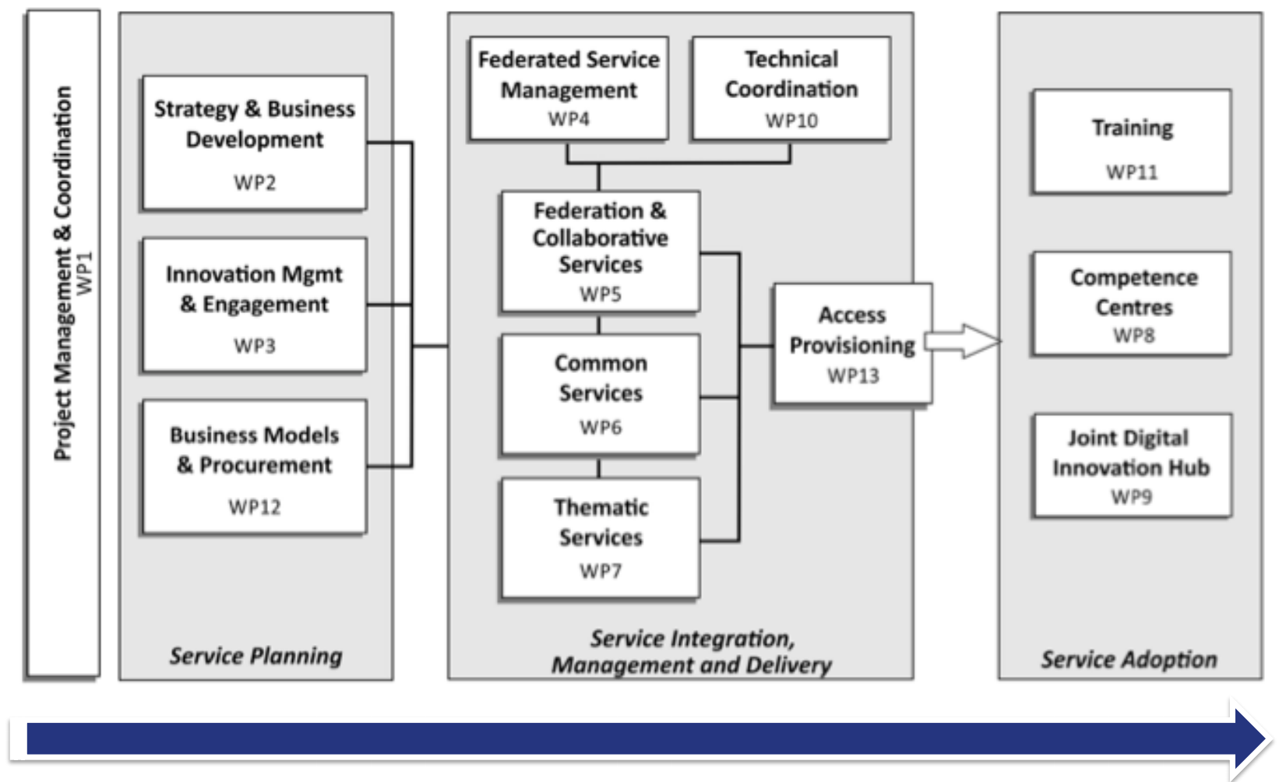
Project Structure

Slide 5
WP4 – Federated Service Management
Task 4.1 Operations Coordination & SFRM, (Matthew Viljoen) (EGI.eu,UCL,PSNC,SNIC,DEIC,EPCC,CINES,KIT,MPG)
Task 4.2 Orders, CRM & SLM, (Giovanni Morelli) (CINECA,MPG,EGI.eu,VUB)
Task 4.3 SACM, CAPM, (Alessandro Paolini)
(EGI.eu, KIT)
Task 4.4 ISM, (David Kelsey) (STFC,CSC,JUELICH,CERN,CESNET,SURFsara,GRNET,STFC)
Task 4.5 ISRM & PM, (David Vicente) (BSC, CESNET)
Task 4.6 CONFM, CHM, RDM, (João Pina) (LIP,CSIC,JUELICH,KIT,MPG)
IT Service Management processes based on FitSM: https://www.itemo.org/fitsm/

Slide 6
WP4 Activities
Operations coordination
coordinating and harmonizing operations work
EOSC-hub operations
participating e-Infrastructure operations
(for EGI linked 3rd parties, this includes integrating with EGI infrastructure and service provision)
ITSM Process related work
developing and working within EOSC-hub ITSM processes
developing and working within participating key e-Infrastructure ITSM processes

Slide 7
Communications Requirements with Service Providers
Project
Service Providers
News
project news
major operational news
security threats
upcoming events
Increasing awareness of supporting services
Training to SPs and their users
Requirements collection from SPs What do you need from the project?
Requirements collection via end users What do your users need from the project?
General concerns
Feedback to project (SPs and users)

Slide 8
Communication – A two-prong approach
Potentially large number of SPs inside EOSC
Need scalable and effective communication
Two modes of communication based on level of partnership
High
Entry
Standard

Slide 9
Service Provider Forum (SPF) Logistics
High
Entry
Standard
Open to all EOSC-hub Service Providers (Entry, Standard, High participation levels)
Possible large number of participating Service Providers. Needs to be scalability.
Reduce demands on peoples’ time to a minimum & provide relevant communication.
Proposal
Virtual meetings (Every 3 months? as needs be)
F2F meeting at EOSC-hub conferences
OPEN mailing list
Membership
All new SP reps join mailing list and encouraged to join virtual meetings
eInfrastructures (EUDAT, EGI) represented collectively
Possible standing agenda items
Project news and upcoming events
Report from security team
General Issues from SPs

Slide 10
Service Management Board (SMB) Logistics
High
Standard
Entry
Open to Standard and High participation level EOSC-hub Service Providers
Co-leadership (as with AMB)
SMB reports to AMB. Any strategic issues escalated to AMB
Reduce demands on peoples’ time to a minimum & provide relevant communication.
Proposal
Virtual meetings (Every 2 months? as needs be)
F2F meeting at EOSC-hub conferences
CLOSED mailing list
Membership
eInfrastructures (EUDAT, EGI) represented collectively
Possible standing agenda items
Problems/status reports from services that are not being dealt with by normal procedures
Policies which require changes/approval of non-strategic changes

Slide 11
Harmonization and Common User Experience
EOSC aims at consistent, quality user experience
Despite heterogenous services, SP backgrounds, funding models, user domains
Achievable by:
Supporting services that work for all
Uniform IT Service Management using sharing common best-practice (ITIL, FitSM)
Lightweight central coordination
Common policies
Sustainable funding mechanism (Virtual Access)

Slide 12
Security Policy Harmonization Work
Aims
New overarching baseline EOSC policies
Remove the need for multiple policies for users
Harmonization of existing e-Infrastructure policies
For High EOSC partnership level services
Plans for SMB to maintain the policies
Work done so far
New policies proposed initially for EGI, EUDAT
Services now being reviewed within EOSC-hub

Slide 13
Acceptable Usecase Policy
Based on WISE Baseline AUP(*)
Necessary to regulate infrastructure access/usage
Foundation for GDPR compliance
Allows for augmentation by community/infrastructure T+Cs
Suitable for integration with federated AAI service
Short and simple. AUP consists of 10 ‘commandments’.
(*) https://wise-community.org/sci/

Slide 14
Service Operations Security Policy
Intended for High participation level services
Augments local policy with Infrastructure specific requirements
Defines roles: AMB, SMB, Collaborating Infrastructure Security Officers
Defines essential requirements for Service Management, Physical+Network Security + sanctions

Slide 15
Security Policy
Compliant with WISE Security for Collaborating Infrastructures v2 (*)
Intended for High participation level services
Augments local policy with Infrastructure specific requirements
Defines roles: AMB, SMB, Collaborating Infrastructure Security Officers
Defines essential requirements for Service Management, Physical+Network Security + sanctions
(*) https://wise-community.org/sci/

Slide 16
Discussion points
What do Service Providers want to get out of the project?
How can the SPF/SMB ensure that requirements are met?
Are there other requirements not covered?

Slide 18
TRL Levels for EOSC
https://confluence.egi.eu/display/EOSC/Service+Maturity+Classification
TRL 7 System prototype demonstration in operational environment
Service has passed through development and is an advanced stage of pre-production: the software is stable, reliable and has been deployed in an operational environment
Functionality as required by the target users is documented, understood, validated with target sample users and accepted by them. Internal documentation exists regarding preliminary validation tests.
An assessment has been made of the required load of the system once the transition into production is complete and a plan has been made to service this load. This assessment has been documented.
An SLA is optional.
TRL 8 System complete and qualified
There are users who are making real use of the service and rely on it for their work.
Service documentation for end-users exists and is made available.
An acceptable use policy/terms of use is in place.
An SLA is in place, with service level targets defined and delivered service level targets periodically reported to the customer. The existence of an SLA implies the following:
Basic (e.g. port up) and functional monitoring in place
Provision is made for user support, with response to incident and problem management is as per SLA
TRL 9 Actual system proven in operational environment
All requirements of TRL 8 are met.
Customer feedback is gathered and documented. The service has been in a production state and relied upon by users for at least 1 year and evidence is provided to show this.
There are quantitative outputs as a direct result of the service usage.
SLA is in place and monitored

