Slide 1
EOSC-hub Week Conference
Prague – April 01-02, 2019
João Fernandes
CERN
HNSciCloud:
Project Results and lessons learned

Slide 2
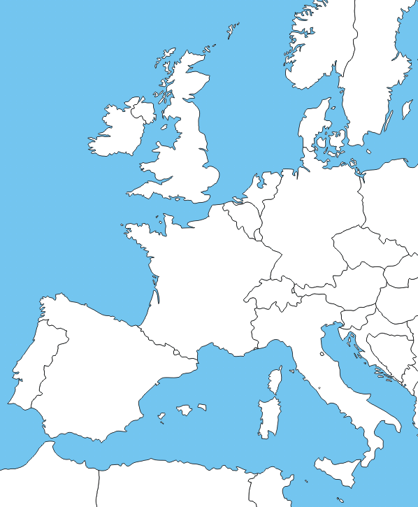
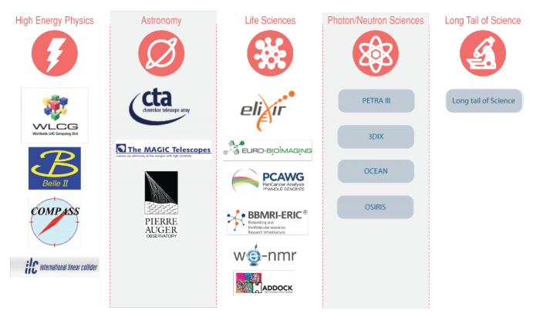
Helix Nebula Science Cloud Joint Pre-Commercial Procurement
Procurers: CERN, CNRS, DESY, EMBL-EBI, ESRF, IFAE, INFN, KIT, STFC, SURFSara
Experts: Trust-IT & EGI.eu
The group of procurers committed procurement funds, manpower for testing/evaluation, use-cases with applications & data, and in-house IT resources
Resulting made available to end-users from many research communities
Deployed in a hybrid cloud mode:
procurers data centres
commercial cloud service providers
GEANT network, EduGAIN and ELIXIR Federated Identity Management
Co-funded via H2020 Grant Agreement 687614
Total procurement budget >5.3M€
Notes:
Research organisations from 7 countries have proposed to work together to develop a cross-border joint procurement of innovative cloud services. This is an important change: never before have research organisations across Europe pooled their funds and resources to procure cloud services to support their scientific programmes.
CERN is the lead procurer while EMBL-EBI & ESRF are members of the buyers group and co-organisers of this event.
The hybrid cloud platform brings together the data centres managed by the procurers, the publicly operated GEANT network and eduGAIN federated identity mgmt. providing consistent access to all cloud services.

Slide 3
Challenges
Innovative IaaS cloud services integrated with procurers in-house resources to support a range of scientific workloads
Compute and Storage
Support a range of architectures, virtual machine and container configurations including HPCaaS, working with datasets in the petabyte range with transparent data access
Network Connectivity and Federated Identity Management
Provide high-end network capacity via GEANT for the whole platform with common federated identity and access management
AAI activities have been described as a ‘pilot’ use-case in a AARC2 project:
https://aarc-project.eu/wp-content/uploads/2018/06/DSA1.1-v1.1FINAL.pdf
Service Payment Models
Explore a range of purchasing options to determine those most appropriate for the scientific application workloads, including vouchers or other means of easy integration in the organisations procurement models and production of a TCO study ready by end of 2018

Slide 4
HNSciCloud project phases
Preparation
Implementation
and sharing
Analysis of requirements
Current market offers
Relevant standards
Build stakeholder group
Develop tender material
4 Designs
3 Prototypes
2 Pilots
Tender Jul’16
Call-off Feb’17
Call-off Dec’17
Jan’16
Dec’18
Each step is competitive - only contractors that successfully complete the previous step can bid in the next
Phases of the tender are defined by the Horizon 2020 Pre-Commercial Procurement financial instrument

Slide 5
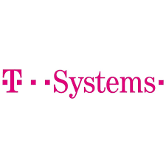
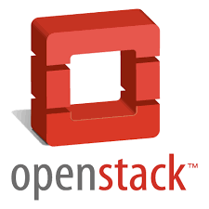
Cloud Providers
T-Systems
IaaS based on OTC
RHEA
IaaS provided by Exoscale

Slide 6
T-Systems

Slide 7
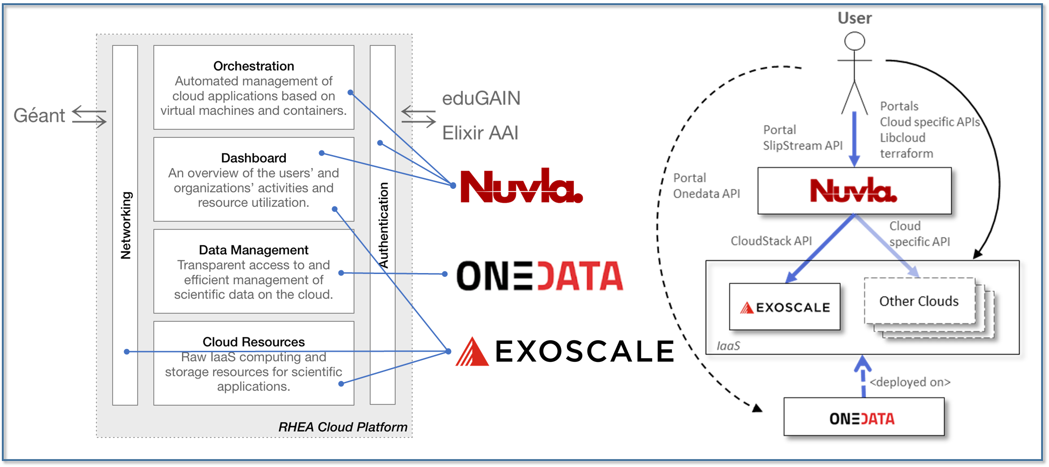
RHEA
Four regions: Geneva, Frankfurt, Zurich, and Vienna
Based on Apache CloudStack
Supports CloudStack API, Libcloud, Terraform and Docker Machine
Simple portal and API to manage workloads
Powerful object storage for cloud native applications
Géant: aggregate 40 Gb/s bandwidth

Slide 8
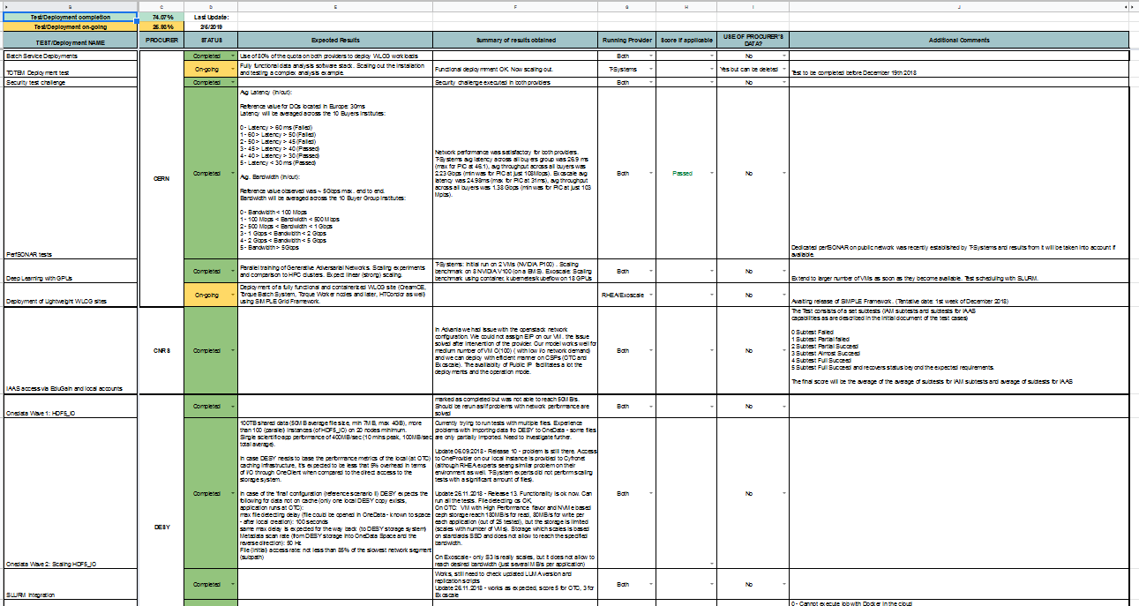
Test Suite
The Buyers Group assembled approx. 30 tests executing them against the commercial cloud providers

Slide 9
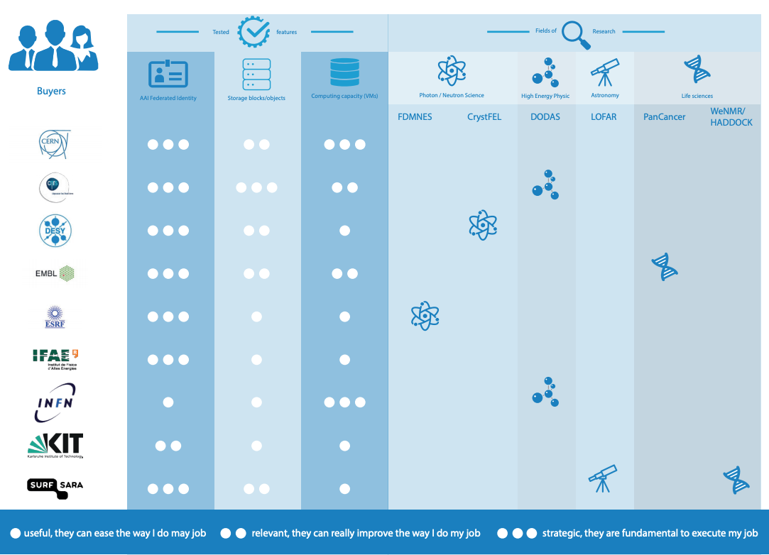
Initial Deployments

Slide 10
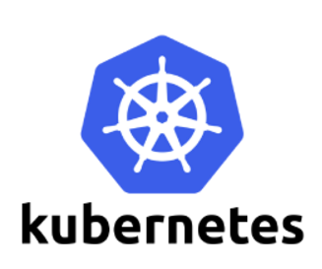
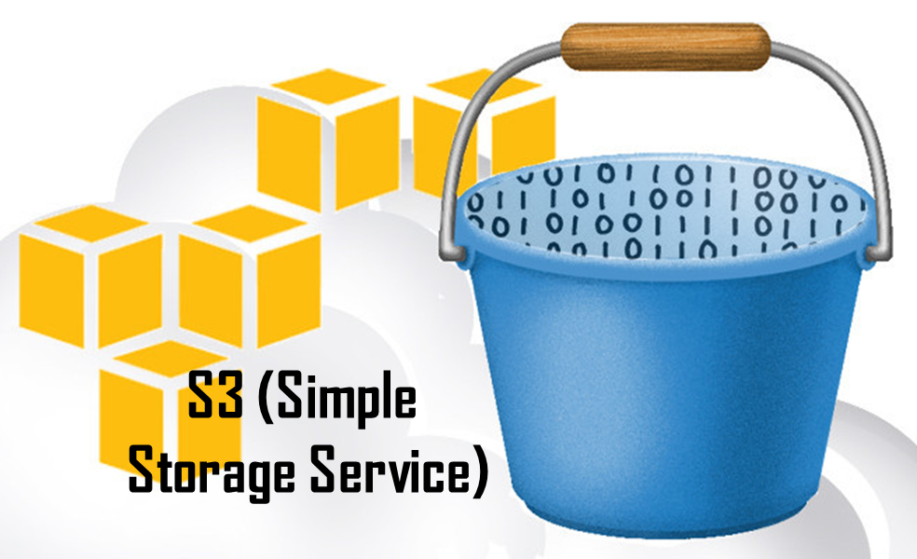
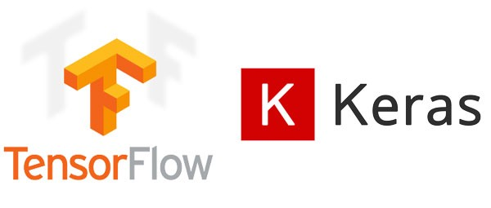
Some more deployed use cases
Integration of commercial cloud capacity in batch services for the LHC experiments
On demand computing facilities generation
CMS Data Reduction Facility – Physics Analysis with Apache Spark
Hybrid Cloud auto-scaling with Kubernetes
DODAS/Lightweight WLCG sites deployments
Interactive user analysis services
Data Management and transparent data access
Pancancer (EMBL-EBI)
HDF5 (DESY)
Grid sites deployment (INFN)
HPCaaS
FDMNES (ESRF)
S3 object stores
Hybrid S3 services for data replication using Ceph
Use S3 for preparatory analysis jobs
Machine Learning and Deep Learning for Simulation
Scale out model training for Neural Network optimization on GPUs
Extend to other hardware accelerators (FPGAs); Generalise the approach to satellite imagery analysis and medical applications

Slide 11
Total Cost of Ownership study
Understand the costs of using commercial cloud services as part of a hybrid cloud model
2 use-cases selected with different requirements
ALICE: single core jobs, up to 50.000 at any time (monte-carlo, reconstruction, analysis)
PANCANCER: burst pattern, with minimal resources constantly used (few VMs) and periods of ramp-up (up to 400 VMs)
Notes:
Educause Center for Analysis and Research, a nonprofit association that helps higher education elevate the impact of IT
intangible benefits of the cloud: geographic diversity of services, fault tolerance, enhanced security and compliance, and automation

Slide 12
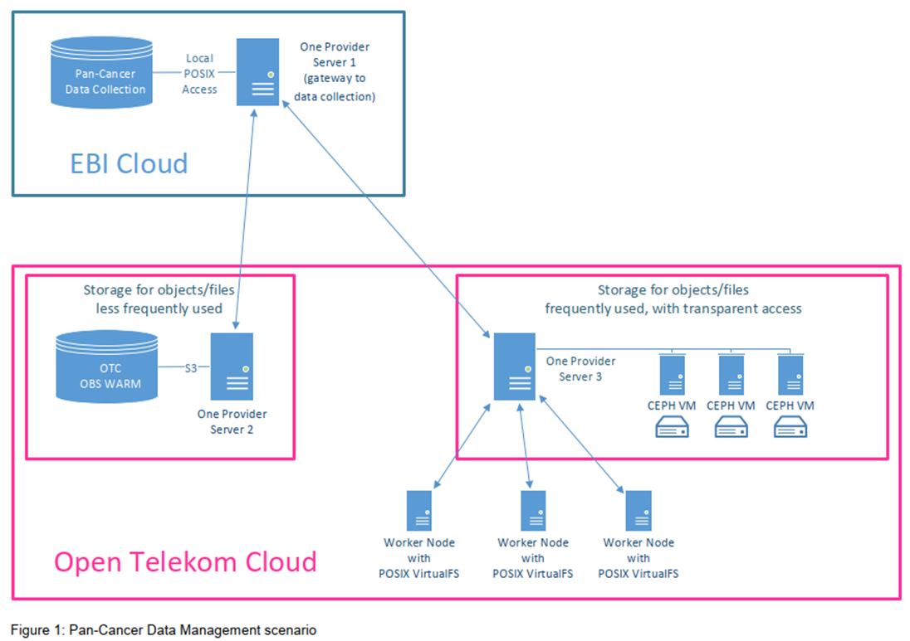
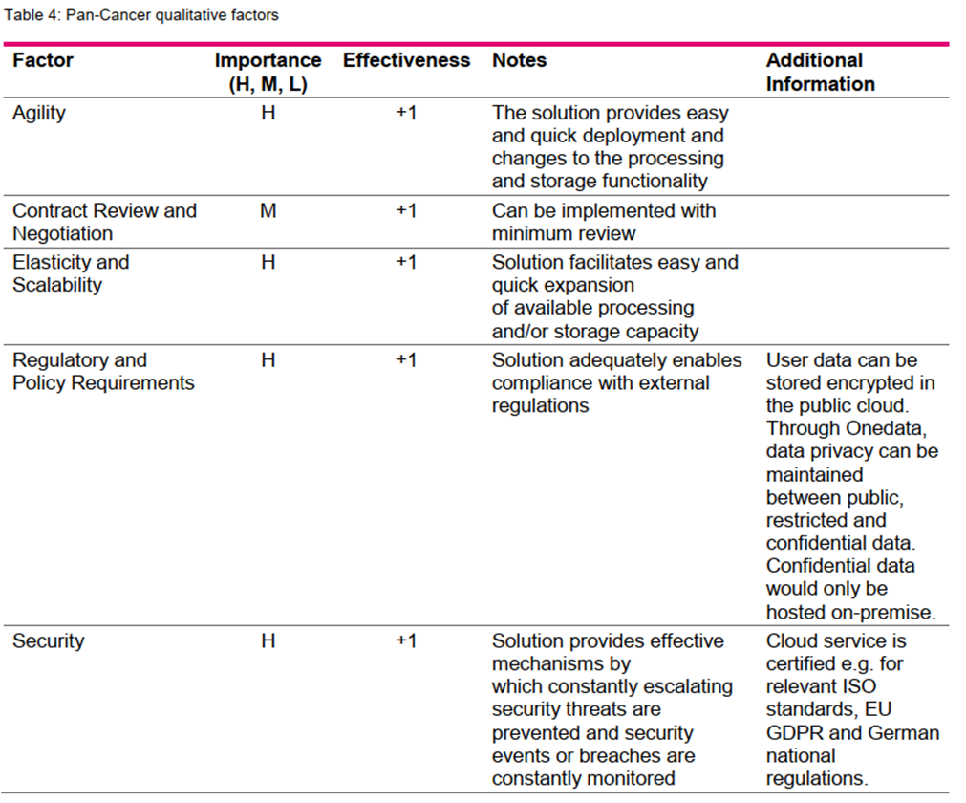
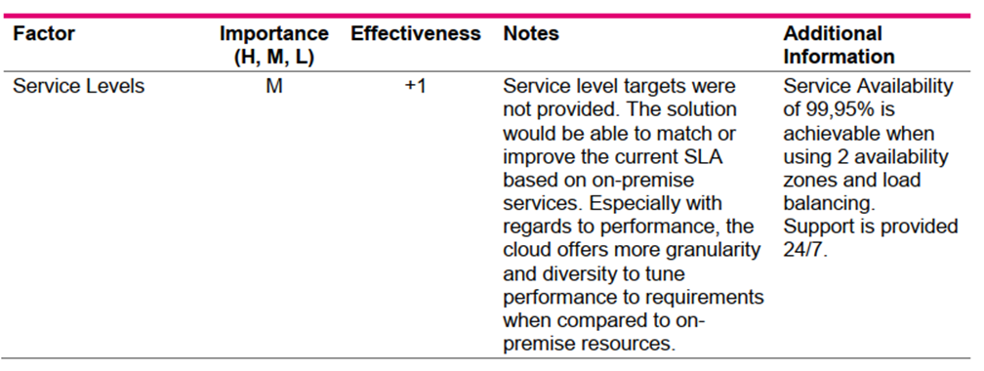
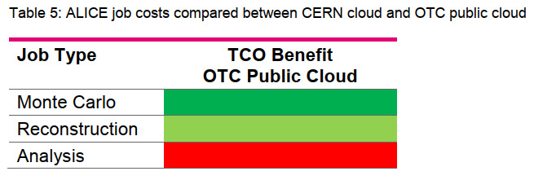
TCO results: T-Systems
“The impact of flavour and VM size on TCO can be significant.”
Notes:
ALICE reconstruction and analysis trains

Slide 13
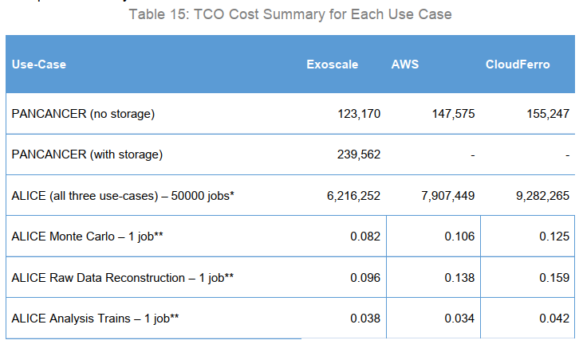
TCO results: RHEA
“The PANCANCER and ALICE use-cases each have their own specific requirements for cloud deployment. Both use-cases have more than one job type requiring different VM flavours and/or pricing options. Also, use-cases can be supported without having to store large volumes of data in the cloud, minimising storage costs. Therefore, we have not included the cost data management solutions, since our assumptions for use-cases are that the data can be ‘streamed’ to the VMs. “

Slide 14
Voucher Credits
Experience in HNSciCloud

Slide 15
Experience from HNSciCloud
Needed a simple & flexible way to distribute part of the procured capacity to end-users.
Explored use of vouchers in the pilot phase
Voucher providers:
Paper published in Zenodo: https://zenodo.org/record/2615456#.XK0lTOszbs0
Encourage the uptake of services deployed in HNSciCloud by Long Tail of Science (LToS)
Perform R&D on cloud providers infrastructure & to validate resources before wider use

Slide 16
The Process
Definition of scheme characteristics
Tests by the Buyers Group
Distribution to end-users
To individual researchers
Validity: 1 Year
To be redeemed under existing tenant
Usage monitoring
Lessons learned
Based on the feedback received
Feedback via survey form
Face value: 250€
Selected by external organisation (Eurodoc)
Apply it in OCRE
Data repatriation
Access to the resources after credit exhausted with additional vouchers
Bringing this experience to OCRE

Slide 17
Essential Features of the Voucher Scheme
Compatibility with Data Management Plans
Simplified user interface & Up to date documentation and trainings
Clear data repatriation policies & Long-term data storage solution
Cost Calculators

Slide 18
Lessons Learned
Framework agreements provide a convenient structure for service procurements in the scientific community
Volume and requirement aggregation across a group of scientific organisations brings advantages ->
Use a small number of cloud providers in parallel to avoid lock-in and ensure service continuity
Need a scientific test validation suite and need to repatriate data at the end of contracts ->
Commercial clouds offer opportunities to rapidly scale cutting edge technology for R&D deployments ->
Vouchers/Credits are a practical means to provide limited-scale access to commercial cloud services for end-users ->
Commercial clouds providers offer services that are certified against international standards (e.g. ISO 27000 family) and consistent with legislation (e.g. GDPR)

Slide 19
Notes:
CERN is the European Organisation for Nuclear research.
It was founded in 1954, so it is more than 60 years old, to do fundamental research in physics.
More precisely, CERN is dedicated to the study of the components of matter, the particles, how these particles interact between them and the forces that hold them together, to better understand the fundamental laws of nature.

