Slide 1
Expanding Capacities & Building Capabilities
EOSC-Hub Week.
Prague, 10th - 12th April 2019
Dr. Isabel Campos,
Project Coordinator
Notes:
Añadir logo de IBERGRID

Slide 2
Project Vision
data
EU-LA
tools
EOSC-synergy will expand the Capacity and Capabilities of EOSC by leveraging the experience, effort and resources of national publicly-funded digital infrastructures in a coherent way, therefore acting also as an incentive for national resource providers.

Slide 3
Project Vision: Rationale and Key ideas
Deployment of an EOSC-enabled digital infrastructure with a critical mass
Designing a rational strategy to deploy FAIR National Data Repositories
Definition of an EOSC software quality baseline
Service Quality Assurance as a Service: SQAaaS
FAIRness checking “as a Service”
CAPACITY
EXPANSION
SKILLS
DEVELOPMENT
FOSTERING SERVICE INTEGRATION
BUILDING
CAPABILITIES
Enable auto-training in EOSC
Explore and implement a MooC solution following a Marketplace approach
Integration of production-level National Thematic Services in EOSC
Thematic service certification based on SQAaaS.

Slide 4
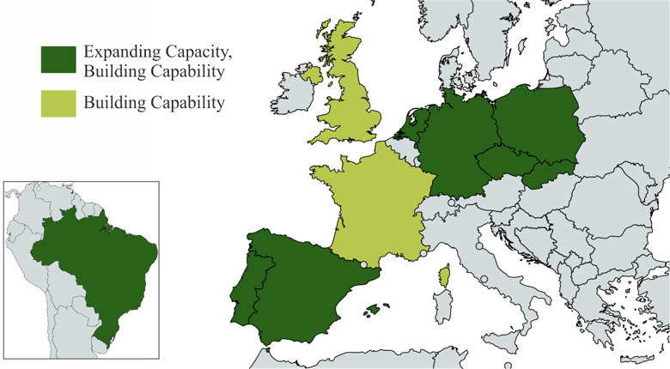
Project Consortium
EOSC-Hub Week. Prague 10-12th April 2019

Slide 5
CAPACITY EXPANSION

Slide 6
Technical Standpoint: Making the leap to EOSC
2001 2004 2010 2017
Building on what we have
Integration at the AAI level
(the Virtual Organization model worked,
but it has limitations)
Monitoring
Grey Zone
EGI Federated Model
Open Science EOSC Model
Integration at the security level
Technical and Policy - wise
Automatization of Resource provisioning
(it always worked manually: VO configuration)
In a nutshell
Policy Level: Actions to be supported by technical developments, notably in the front of Security (data privacy policies) and access policies
Technical Integration Level: work to be done/extended, building on the previous experience.
EOSC-Hub Week. Prague 10-12th April 2019

Slide 7
WP2: National Data Repositories
Open Access policies generated discussions at the country level.
Open Access to documental information is one thing (scholarly communications)
Open Data Access to Scientific Data is something else
EOSC-synergy is an opportunity to pilot concrete implementations
DANS is a key partner to bring in expertise in this domain (direct link to FAIRsFAIR)
DIGITAL.CSIC has the mandate to pilot Open Access in Spain
FCT in Portugal wants to pilot data repositories for long tail for the long tail of science (large organized communities have their own solutions in place).
JISC, CESNET, PSNC and IISAS playing key policy roles on their respective countries as well.
EOSC-Hub Week. Prague 10-12th April 2019

Slide 8
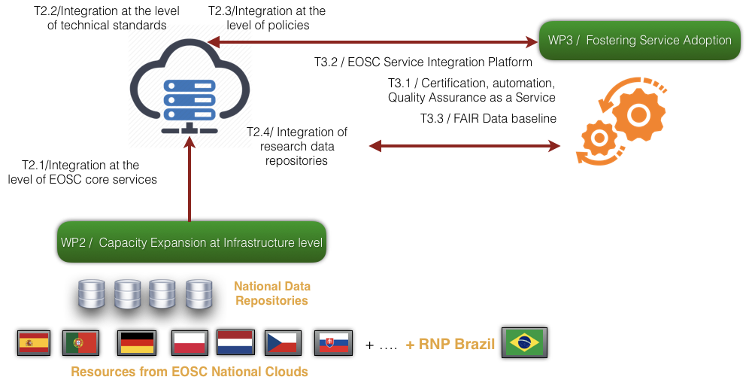
WP3 - Fostering service adoption
Answers from users in RoP EOSC consultations
“Give me something that works”
“EOSC Marketplace cannot be a cemetery of
broken links to poorly maintained services”
EOSC-Hub Week. Prague 10-12th April 2019

Slide 9
POLICY INTEGRATION:
A HOLISTIC VIEW

Slide 10
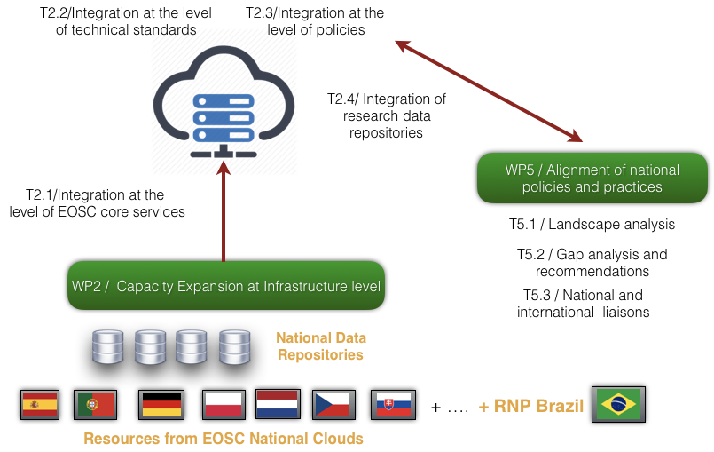
WP5 – Alignment at the Policy Level
EOSC-Hub Week. Prague 10-12th April 2019

Slide 11
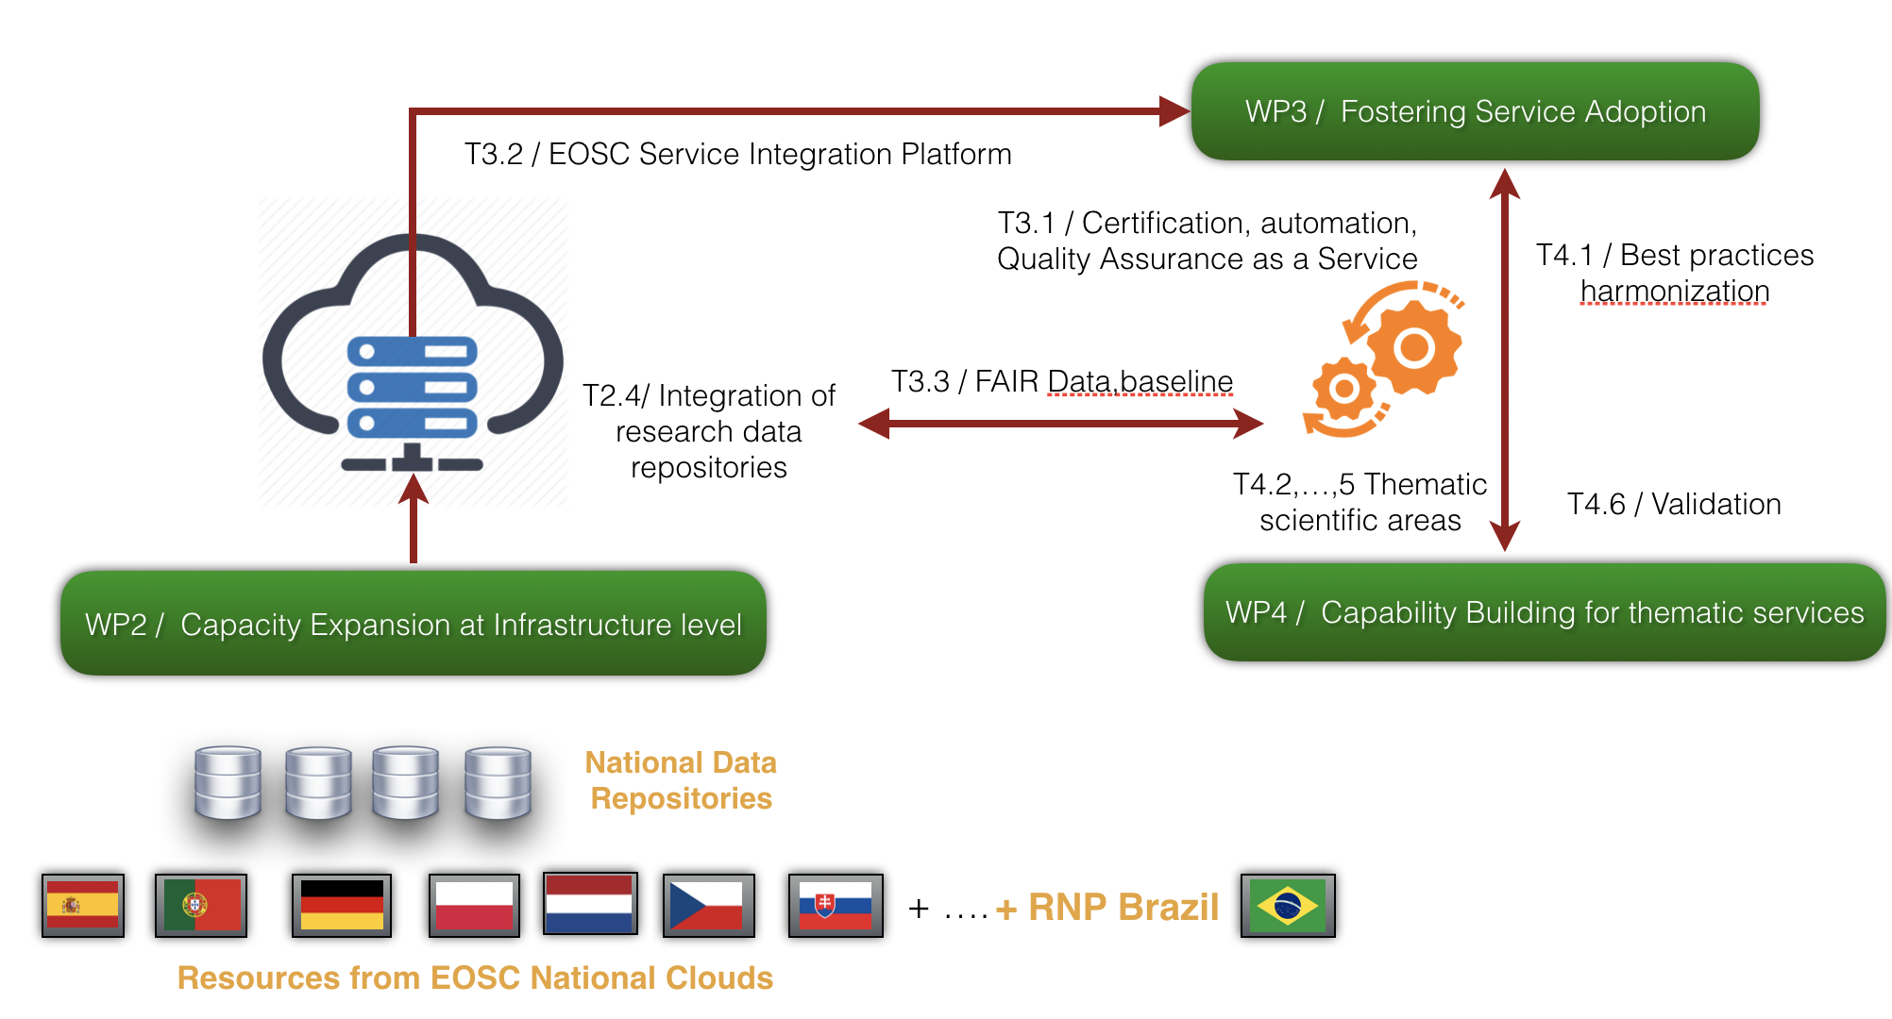
WP4 - Thematic Services Integration
EOSC-Hub Week. Prague 10-12th April 2019

Slide 12
LOWERING EOSC ADOPTION BARRIERS

Slide 13
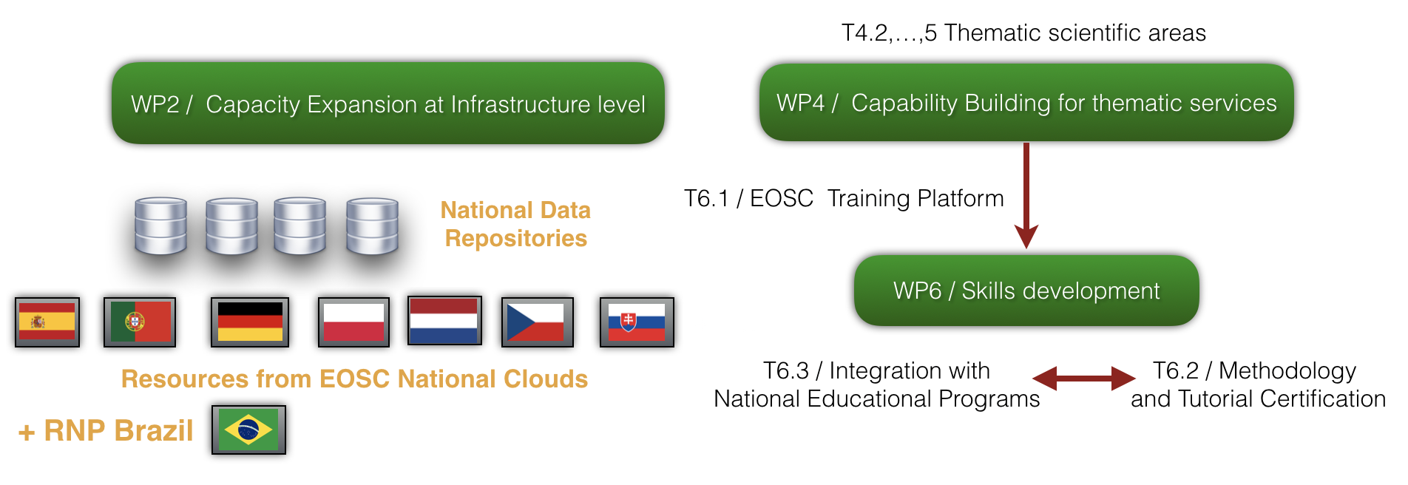
Adding training as fully-fledged EOSC Portal component
CURRENT SITUATION
Lack of a global EOSC wide coherent approach to training.
Training materials scattered.
Lack of funding for training in situ.
EOSC-SYNERGY will
Add training as fully-fledged EOSC Portal component.
Provide guidelines and recommendations for high-quality training materials, oriented to training the trainers.
Provide infrastructure to support self-learning.
Provide infrastructure for massive open online courses (MOOCs).

