Slide 1
Roksana Dobrzanska, Tiziana Ferrari
EOSC Portal future plans

Slide 2
Portal Highlights
Main expectations
Architecture
Capabilities for EOSC Customers
Capabilities for EOSC Providers to support different integration models
On-boarding
Registration and management
Ordering
Interoperability Framework
EOSC Catalogue Framework, Open APIs Service Integration and Management
Different types of EOSC Resources
Notes:
common understanding of what portal should represent, who it should support and in which way basing on expactations of different stakeholders
in order to achieve a common vision we need to speak one language, therefore, based on what have already been accomplished in eosc pilot and fitsm , we need to update our glossary so it reflects new concepts and findings
to support a broad spectrum of means to facilitate european research, eosc portal will include a fine number of components, some of them already existing or under dev in ongoing projects. An updated architecture acknowledges the current situation (probably need to rephrase that) and shows interconnections and dependencies between them
revised understanding of business models that need to be introduced to support service composition and delivery for the Customers
EOSC as a supportive infrastructure to enable providers with guidance and means for professional service delivery, broaden customer base, possibility to integrate with other EOSC resources to create high level solutions and services
possibility for the Providers to register Resources and deliver them to EOSC according to the EOSC business model of choice. It is anticipated that these capabilities will evolve with the definition of the EOSC business model(s), and that different levels of participation will be supported.
EOSC to deliver a broad spectrum of solutions for science - EOSC Resources (services, datasets, software, support, training, consultancy, etc.) for advanced data-driven research. Portal should enable the providers a possibility to present and fit all of them. Need to broaden the EOSC Catalgoue Framework to include descriptions of various resource types. eosc portal to collaborate with research comunities to become aware of their needs and include their findings

Slide 3
What should it be about
Provide a European-level delivery channel connecting the demand-side (the EOSC Customers) and the supply-side (the EOSC Providers) to allow researchers to conduct their work in a collaborative, open and cost-efficient way for the benefit of society and the public at large.
Improve the provisioning of access to integrated and composable products and services from the EOSC Catalogue
Enable different kinds of Users, with different skills and interests, to discover, access, use and reuse of a broad spectrum of EOSC Resources (services, datasets, software, support, training, consultancy, etc.) for advanced data-driven research.
Support interdisciplinary research and facilitate Resource discovery and access at the institutional and inter-institutional level.
Allow researchers and institutions to focus on value creation through sharing and reuse as opposed to duplicating Resources and increase excellence of research and European competitiveness.
Facilitate the composition of services and products to support multi-disciplinary science for example with high-level community-specific interfaces for running workflows involving EOSC services.
Help Providers gain additional insight into potential Users outside their traditional constituencies.
Give Providers the possibility to offer Resources under homogeneous terms of use, acceptable use policies, and in different configuration options, so that Users are guided in the choice.
Notes:
Give Providers the possibility to offer Resources under homogeneous terms of use, acceptable use policies, and in different configuration options, so that Users are guided in the choice. - not sure what this one is about
maybe make this slide more concrete, less text
It lacks the certification aspect which appears on integrations type

Slide 4
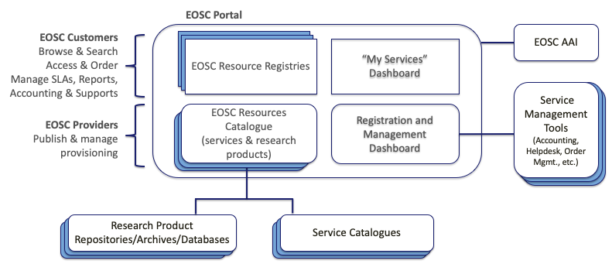
Portal architecture
Notes:
try to get the diagram itself so it can be turned into an animation
Description from the concept, to be updated:
From a EOSC Customer point of view, browsing, searching, access and ordering will be possible through the EOSC Resource Registry/Registries. According to the EOSCpilot Glossary 1.0, the EOSC Resource Registry provides the descriptions of live / ready-to-use EOSC Resources offered by the EOSC System. which exposes the necessary capabilities. Resources will include services and scientific products that are produced by scientists, like data, software, publications, tools and experiments. These are published for discovery and reuse with metadata and links to other products via dedicated sources, e.g. repositories, archives, databases. To facilitate their discovery, cross-discipline or thematic metadata aggregators are today available and widely used by scientists. The EOSC Portal will integrate with scientific product catalogues capable of serving the needs of researchers from different disciplines. Dedicated Registries will be possible in order to present the EOSC offer to specific Users groups.
From a EOSC Provider point of view, the Catalogue comprises “the list of all live EOSC Resources that can be requested by EOSC System Users”. Resources are described by metadata that is either directly inputed after successful validation by the Provider, or through APIs. The Registration & Management Dashboard will provide capabilities supporting the Provider in the on-boarding and validation procedure, and additional functions for integrated service management of the contributed Resources within EOSC. The Additional capabilities for the Providers willing to in that choose a high-level partnership.
The EOSC AAI service, conforming to the AARC blueprint architecture and operational guidelines, supporting: (1) uniform representation of unique Users identifiers, (2) a standardised way of expressing group membership/role/information and Resource capabilities, (3) non-web browser based access, (4) delegation, (5) release of mandatory Users attributes according to the REFEDS research and scholarship entity category, (6) operational security, incident response and treacebility - REFEDS Sirtfi, (7) privacy requirements for processing personal information following the GEANT Data Protection Code of Conduct, (8) rules and conditions that govern access to and use of Resources following the WISE Baseline Acceptable Use Policy, and (9) assurance information following the REFEDS assurance framework and IGTF/AARC assurance profiles.
External catalogues, repositories, databases and archies, providing metadata on services and other products (e.g. datasets, software, applications). Interoperability will be enforced with the adoption of the EOSC Catalogue Framework (see the “Interoperability Framework” section).
External tools for service management (accounting repositories, helpdesk, order management tools etc.), which will exchange ticket information, usage information and order information that are managed externally. Interoperability will be ensured through a Service Integration and Access Management interoperability framework, that will be developed by the EOSC-hub project.

Slide 5
User driven approach
EOSC Portal to distinguish two main user journeys depending on a customer type
Business-to-Customer (B2C)
For consumer-oriented Resources
Large potential User pool
Aimed at automated or semi-automated provisioning
Business-to-Business (B2B): for the acquisition of bespoke solutions and/or of
Large quantities of EOSC Resources involving potentially multiple Providers
Bespoke solutions
For the research performing organizations and research infrastructures, research projects
Large pool of end-users with need of an unified access layer
Aimed at resource composition and integration aimed at serving complex research use cases
Notes:
based on the experience and analised use cases already handled in the portal, expectations depending on the customer type differ a lot. single researcher or small collaboration based requests to access the services tend to focus on a small number of services with low level entry barrier (service should be as easily accessible as possible, resources to learn how to reach a service ir start using it if complex are limited). With large collaborations its mostly about service compositions, requests of service integration for a deditated (complex) use case
b2b: for the acquisition of bespoke solutions and/or of large quantities of EOSC Resources involving potentially multiple Providers. B2B suits the needs of research performing organizations and research infrastructures that need to cater for the long-term needs of a large pool of end-Users. A B2B transaction will typically involve a decision maker from the Customer organization, and the long-term consistent supply of Resources. B2B caters for the needs of research communities with advanced needs that require customization and technical enabling expertise. The Portal will support the negotiation of service quotes, and the possibility for multiple suppliers to respond in a coordinated manner. From a Provider’s point of view, B2B transactions will require the availability of a technical team with a clear understanding of the service components necessary to meet the User needs, and a higher level of service management integration in EOSC, e.g. for coordinated accounting, monitoring, support, SLA and service report management and IT security management.

Slide 6
User driven approach
Portal should clearly guide the Customer basing on his profile: tailored GUI, keeping the Customer in the center so he can understand what EOSC has to offer and how it can be consumed depending on the brought use case
Portal should facilitate resource browsing based on user’s profile indicators:
branch of science
type of research collaboration
initiatives and platforms recognised by the user
Guidance in service composition
Dedicated space for managing resource access requests to support user’s use case
a place to facilitate EOSC - Customer dialogue
User-driven catalogue evolution
rating
requests to integrate the existing resources and create a new one
Notes:
is EOSC Resources the right terminology?

Slide 7
EOSC Portal capabilities for EOSC Providers - Access Models
Orderable Resources with external ordering (Catalogue type)
Open Access - Resources open to everyone
Orderable Resources with internal ordering
Lightway integration (e.g. communication to support the orders via dedicated email registered with the ticketing system)
Medium integration
Tight integration (the provisioning as automated as possible)

Slide 8
Possible tiered partnership scenarios for EOSC Providers
Invisible coordinator: The Portal publishes Resources from multiple Providers, however their Resources are natively delivered to the EOSC Customers through the Provider’s specific delivery channel.
Matchmaker: The Portal receives from the EOSC Customer the request for a specific Resource or a specific functionality offered by a Resource. It matches the request with respect to the multiple Providers that can offer it.
One-stop-shop: The Portal acts as single entry-point for a functionality that it delivered through the participation of multiple EOSC Providers. The distribution is transparent to the EOSC Customers as all the details related to the heterogeneity that may exist behind.

Slide 9
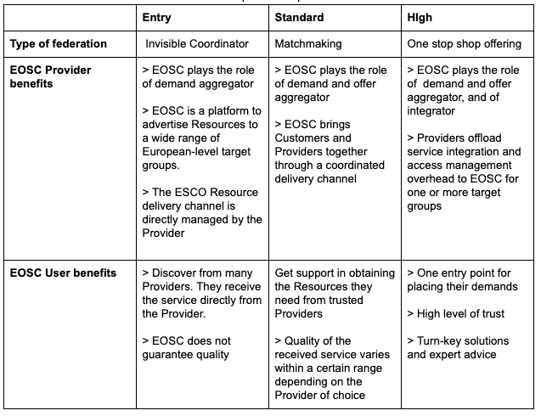
EOSC benefits in tiered partnership scenarios

Slide 10
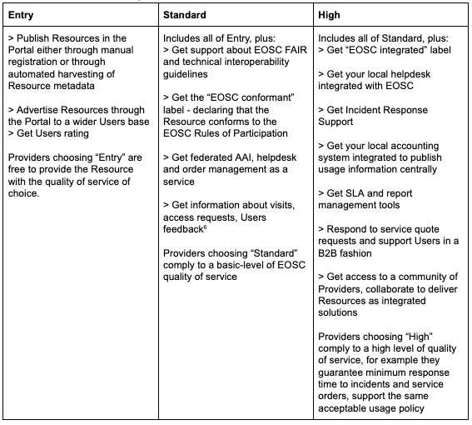
Aspects of possible integration types
Notes:
with the quality of service choice - ????

Slide 11
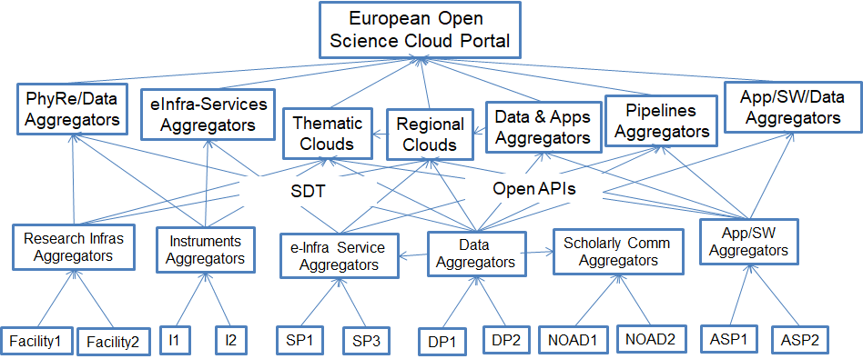
EOSC Catalogue interoperability framework
EOSC Catalogue Framework (ECF),
the Open Application Programming Interfaces (APIs)
related Quality Assurance measures
Use of the EOSC Catalogue Framework guidelines allows for harvesting and exporting of metadata across different catalogues, archives, repositories and databases.

Slide 12
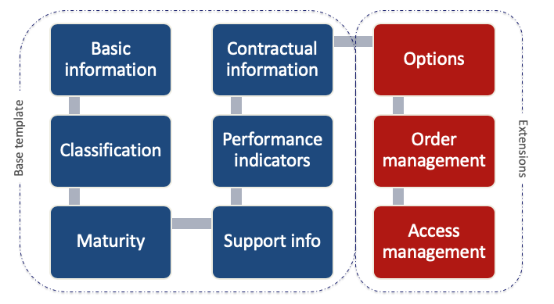
EOSC Service Definition Template
Based on the work of the eInfraCentral and EOSC-hub projects
Dependant on level of integration
Need to create templates to support another Resource types

Slide 13
https://www.linkedin.com/in/roksana-er/
r.rozanska@cyfronet.pl

