Slide 1
Joining the EOSC Ecosystem
Matthew Viljoen, EGI Foundation
WP4 Leader
Dissemination level: Public

Slide 2
Participate in EOSC
Users & customers
EOSC Portal
Integration (optional)
Science community providers (from EOSC-hub and beyond)
EOSC service catalogue
Services (inc. thematic and onboarded)
Services from e-Infrastructures
Basic infrastructure
Compute and storage
Federation Services
AAI, Accounting, Monitoring, Operations, Security
Added value services
Compute, data, software management, curation & preservation
Open Collab. Services
Application/software repository, Configuration management, Marketplace
E-infrastructure providers (from EOSC-hub and beyond)

Slide 3
EOSC makes services and data F.A.I.R.
Findable → Harmonized service descriptions; Catalogue (→EOSC Portal); PID service (B2HANDLE); Software and VM catalogue (AppDB), …
Accessible → Marketplace; Federated login across services; Harmonized access policies; …
Interoperable → Portable and scalable compute and storage; Orchestrators; Growing, community-defined standards; …
Reusable → Training & documentation; Long-term preservation service (B2SAFE)

Slide 4
EOSC also helps to make services reliable
Service validation (when entering the catalogue)
Aligned service management practices (based on FitSM processes)
Service monitoring with configurable test probes (based on ARGO)
Operations security (distributed Software Vulnerability Group)
Helpdesk reaching distributed service operators

Slide 5
EOSC helps in different ways
For users
The ‘one-stop stop’ for discovery and access to services
Common support and user experience
Training opportunities
For services providers
A new entry point for their service – access to new users
Supporting services that may be integrated
Best practice with service management
Security expertise within project
Future funding opportunities via Virtual Access

Slide 6
EOSC Support for the Research Data Lifecycle
Access, Deposition & Sharing
Application DB (software & VM)
B2DROP (data)
B2Note (data)
B2SHARE (data)
DataHub
4
Data Management, Curation & Preservation
Discover & Reuse
B2HANDLE
B2SAFE
European Certified Trusted Repository
3
1
B2FIND (data)
Marketplace (Services)
2
Processing & Analysis
Applications on Demand
Federated HTC & Cloud Compute IaaS & PaaS
Processing of sensitive data
Jupyter Notebook
Thematic data analytics
Scientific Workflow Management, Orchestration (DIRAC, PaaS Orchestrator)

Slide 7
The EOSC Service Ecosystem
Portal
Federated AAI
Helpdesk
Messaging
Accounting
Onboarded Service
Ops Support
Security
Collab. Tools
App Store & SW Repos

Slide 8
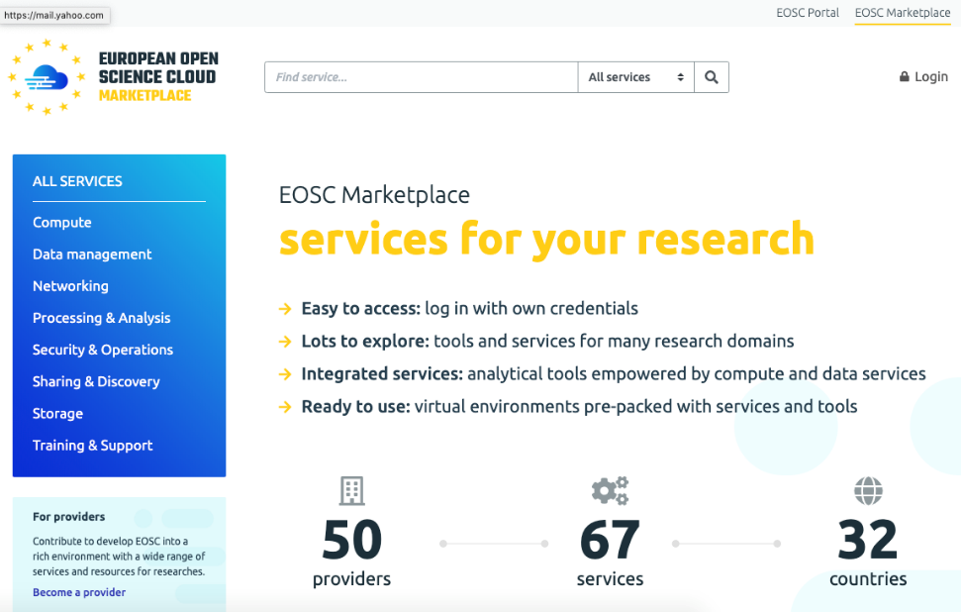
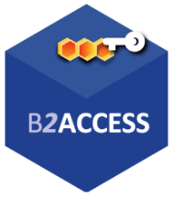
Supporting services
Marketplace and Order Management
Service Discovery and Service Catalogue Management
Order management processes integrated to onboarded services
Helpdesk
Consistent single front-end routable to multiple service providers
First line support
Federated AAI
Scalable authentication/authorization/group management solutions (based on AARC BPA)
Credential translation services
https://helpdesk.eosc-hub.eu/
IAM
Check-in

Slide 9
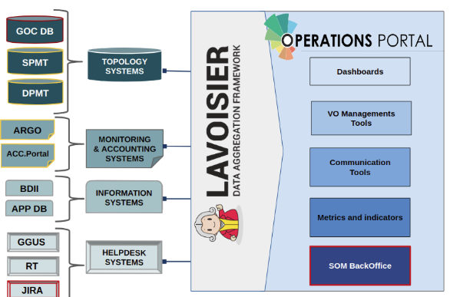
Supporting services
Operations Tools
Operations Portal, Portfolio Management Tools, Information System, SLM, SRM Tools
Monitoring and Accounting
Complete monitoring and computing/storage accounting solutions
Security Tools
Security Monitoring supporting the Security Team
Application Store and Software Repositories
Distribution of software and applications for end users and systems administrators
Pakiti

