Slide 1
EO[D|S]C
Christoph Reimer
EODC – Earth Observation Data Centre

Slide 2
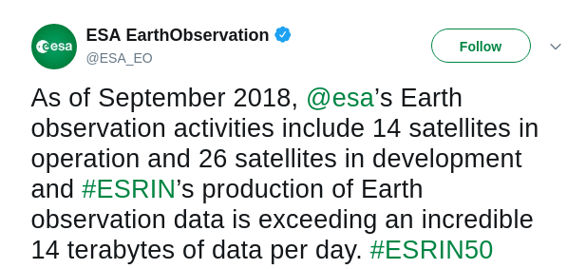
EO – A European success story
Notes:
14 satellites
Copernicus
As heard yesterday by Andreas Veispak (EC)--> 5 PB/year

Slide 3
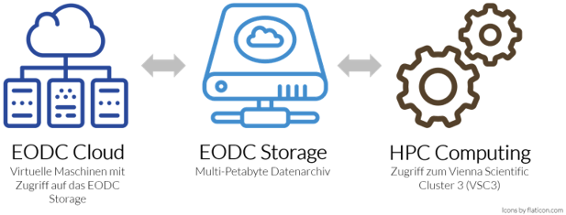
Earth Observation Data Centre [EODC] Collaboration for Earth Observation
Copernicus Program was the "game changer": New paradigm in EO data processing
Bring software to data
Cooperation & specialisation
Setup a new public-private organisation to develop the required resources
EODC foundation 15th May 2014
EODC acts as community facilitator with the goal to
focus on collaboration between the public and private sector
establish, manage and operate IT infrastructure
connect science and operations
Notes:
Mention that we store 4.7 PB of raw satellite data only.
As we also heard yesterday, EU is very good in science but bringing science to operations lacks behind!!!!

Slide 4
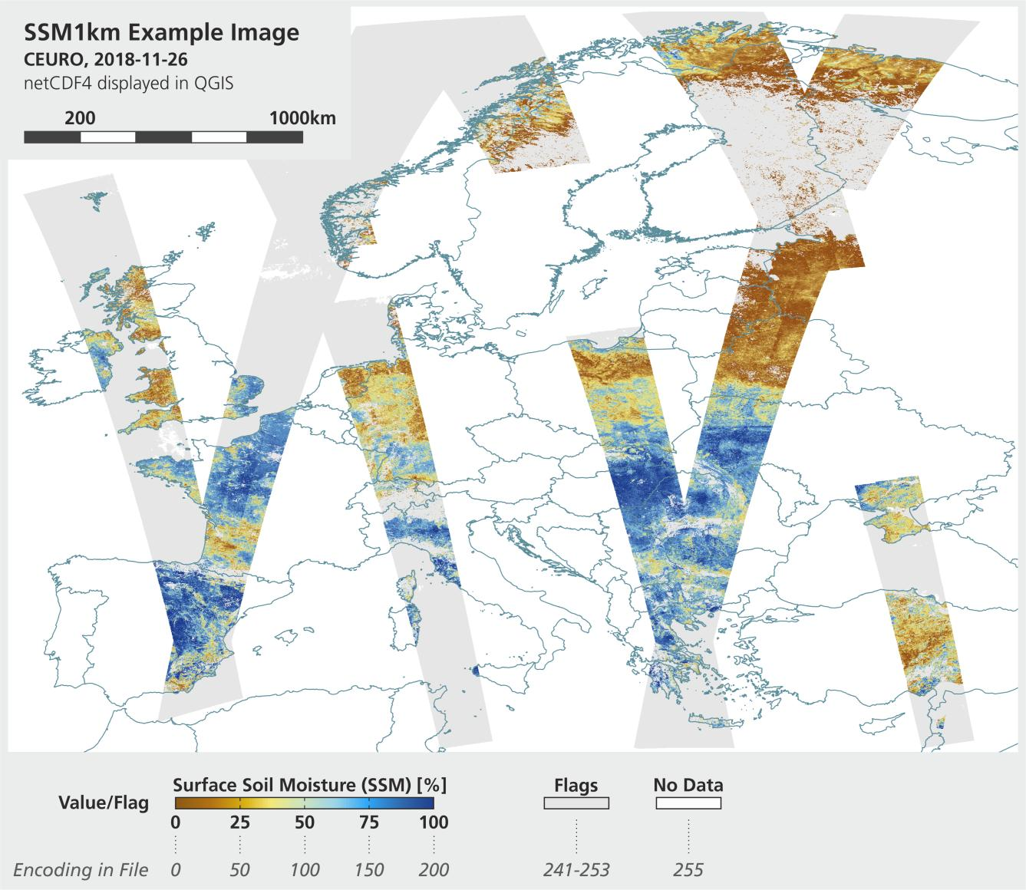
From science to operations
Sentinel-1(A/B) SSM 1 km
Timeliness: Daily
Partners: TU Wien and ZAMG
Fusion of 10+ satellite mission to 9 different products
Timeliness: 10 days
Partners: TU Wien and VanderSat

Slide 5
What EODC (can) bring to EOSC
Cloud Compute and Storage Resources
Enable access to HPC environment (VSC-3)
Data from Copernicus Sentinel missions and other missions
EO expertise and services
Potential new partners from the public and private sector
New possibilities for co-operations / federations with the EO community

Slide 6
What EOSC (can) bring to EODC
Potential federations and exchange with other communities / disciplines
Development of new services and tool sets
Joint efforts to resolve common issues
Data sharing options and access protocols, data and metadata standards
Data life cycle management
Access to an extended network of resources within GEANT
Use of synergies to provide services to store and process data
Open up EODC services to a broader community
Potential access to EOSC services for EODC users

Slide 7
Summary
Earth Observation (Copernicus Program) is and will be an innovation driver
EODC is transitioning from science to operations with partners from the public and private sector
EO[D|S]C complement one other by enabling additional opportunities
EODC can bring EO know-how to EOSC
EOSC brings extended network and additional communities to make use of EO data
"no one can do all", Federations are key to success

